Slide 1

Using the AIM Portal for Instructors
Disability Services
Division of Student Affairs

Slide 2
Using the AIM Portal for Instructors
Overview of the AIM Instructor Portal
The Office of Disability Services at Xavier University of Louisiana now uses Accessible Information Management (AIM), an online accommodation management portal that helps students request and coordinate their accommodations with instructors.
This system will also allow instructors to be able to review accommodation requests in a central location and will help facilitate the exam proctoring request process through a web interface rather than by email and paper forms – if instructors choose to utilize the Disability Services Testing Center to administer their exams with disability accommodations.

Slide 3
What can Instructors do in the AIM Portal?

Slide 4
View list of students who have requested accommodations in their courses.
Review Faculty Notification Letters (Accommodation Letters) in a central location.
Complete Testing Agreements that outline the details for all exams in your class.
Review Exam Requests submitted by students in their courses.
Upload exams to the AIM Portal for administration.

Slide 5
Faculty Notification Letters emails
Faculty Notification Letters (Accommodation Letters) will be primarily be emailed to the instructor from the AIM system. The email will be addressed from the student’s assigned Access Coordinator (Case Manager in AIM) and the student will receive a copy of each email when the notifications are sent. This replaces the old process of sending regular emails from Disability Services.
The subject line will read: [DR] Student Name – Course Number – Course Title (CRN) – Accommodation Letter
It will be addressed from: XULA –Office of Disability Services <disabilityservices@xula.edu> on behalf of Case Manager<email address>

Slide 6
Viewing the Faculty Notification Letters in AIM
In the AIM INSTRUCTOR PORTAL Faculty Notification Letters/Eligibility Letters (Accommodation Letters) will also be available to review on the Overview page by clicking on “View” next to the student’s name in the student listing.

Slide 7
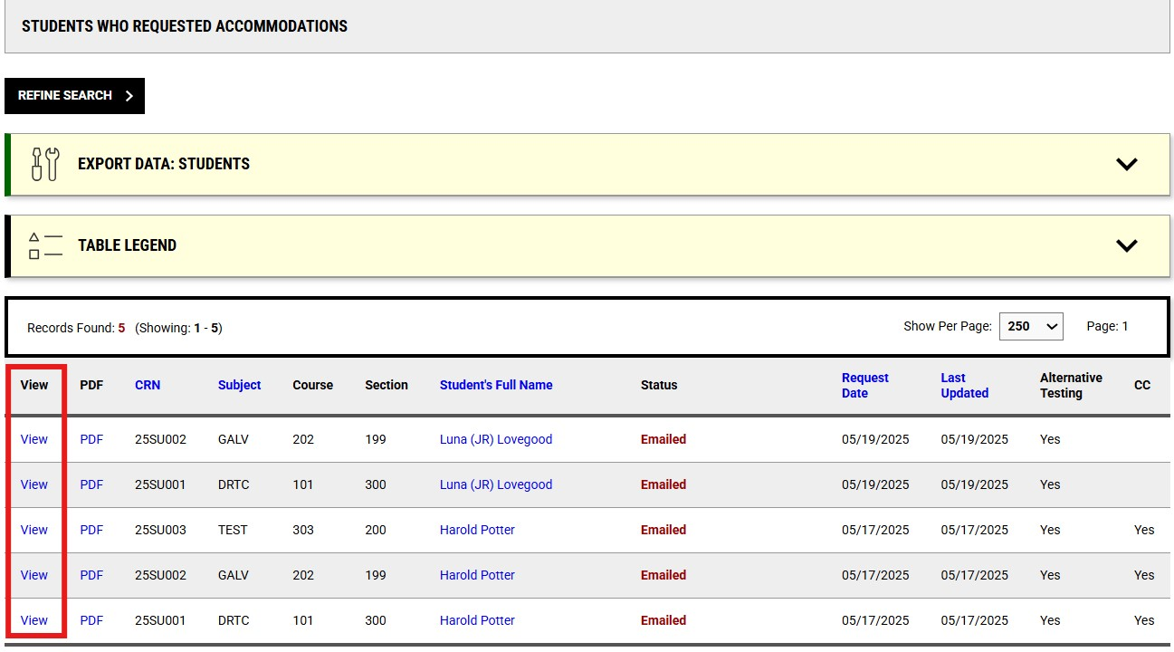
Viewing the Faculty Notification Letters in AIM
In the AIM INSTRUCTOR PORTAL Faculty Notification Letters (Accommodation Letters) will also be available to review on the Overview page by clicking on “View” next to the student’s name in the student listing.

Slide 8
Completing the Testing Agreement
Instructors should indicate if they plan to use the Disability Services Testing Center (DSTC) to administer their exams with accommodations by completing the Testing Agreement.
A link to the Testing Agreement will be available in the Faculty Notification Letter (Accommodation Letter), also is available through the AIM INSTRUCTOR PORTAL.
Instructors need to only complete one Testing Agreement for each course/section. If they are teaching multiple sections, they can copy the agreement to multiple courses within the AIM Instructor Portal.

Slide 9
Completing the Testing Agreement
When an instructor chooses to work with the Disability Services Testing Center to administer accommodated exams for students, a Required Instructor Questionnaire) (also known as just a testing agreement) is needed to ensure we administer your exams to the same standards and expectations used for students testing in your classroom.
The testing agreement is a short questionnaire which provides the Testing Center with details on the dates/times of your exams, what materials are provided, what students can and cannot use during the exam, and other information which helps us to administer your exams the way you do for other students. Without a testing agreement, we are unable to administer exams for your course. Instructors will receive automated reminders and communication from the Testing Center until they complete the testing agreement or indicate they intend to proctor their own accommodated exams.

Slide 10
To begin the process of completing the Testing Agreement for your course(s), do the following:
Access your AIM INSTRUCTOR PORTAL
Click the Alternative Testing link in the menu on the left-hand side.
Click the Testing Agreement (Required Instructor Questionnaire) link in the horizontal menu at the top of the Alternative Testing dashboard.
Click the Specify the Testing Agreement (Required Instructor Questionnaire) for each course where an agreement is Not Specified.
Please complete your testing directions at least 3 school days prior to the scheduled exam date.
Use the link below to submit your exam instructions:
Testing Directions (or copy and paste the following link to your browser: https://loa.accessiblelearning.com/XULA/Instruction.aspx?ID=10587&CID=74782&Key=gTSIU5Lz)
This ensures we can properly administer your exam according to your preferences and the student’s accommodations. Thank you!

Slide 11
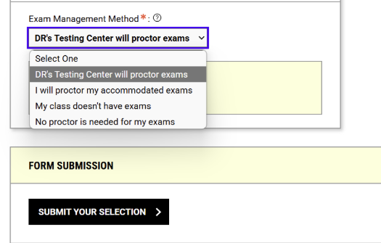
If you select any other option for Exam Management Method, the testing agreement will be closed and students will not be able to schedule accommodated exams for this course

Slide 12
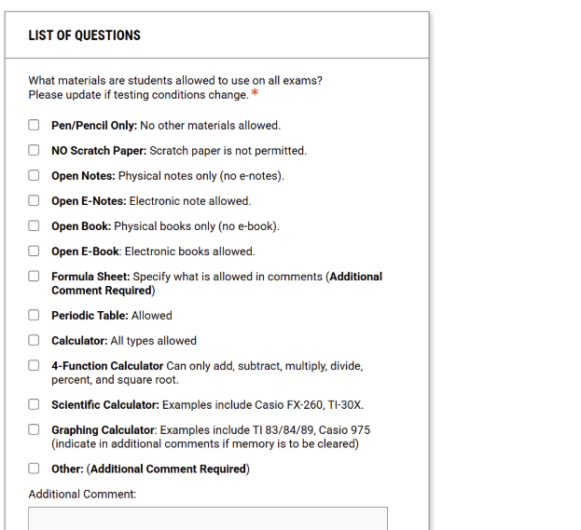
As you complete the testing agreement, you will specify details about your exam, the materials students may bring and how they can schedule your exam with the Testing Center. You are also now asked to provide dates/times for each of your exams, which will allow AIM to check against your list of approved dates/times when approving or declining exam requests by students. You will add one exam date/time on the first page of the testing agreement and then are prompted to add additional dates/times on the subsequent page. As you click the Submit or Save Exam Date buttons, the testing agreement will automatically be saved and AIM will display a success message to confirm your submission.

Slide 13
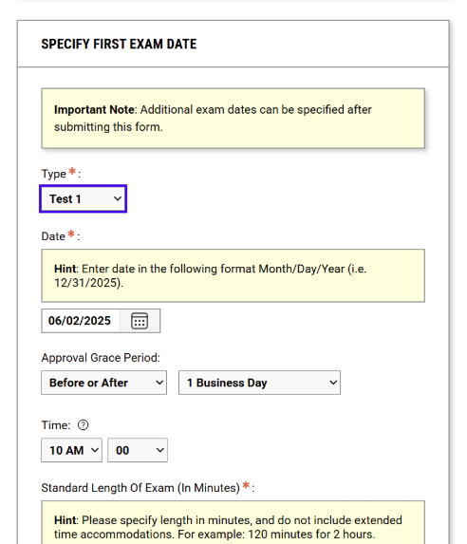

Slide 14
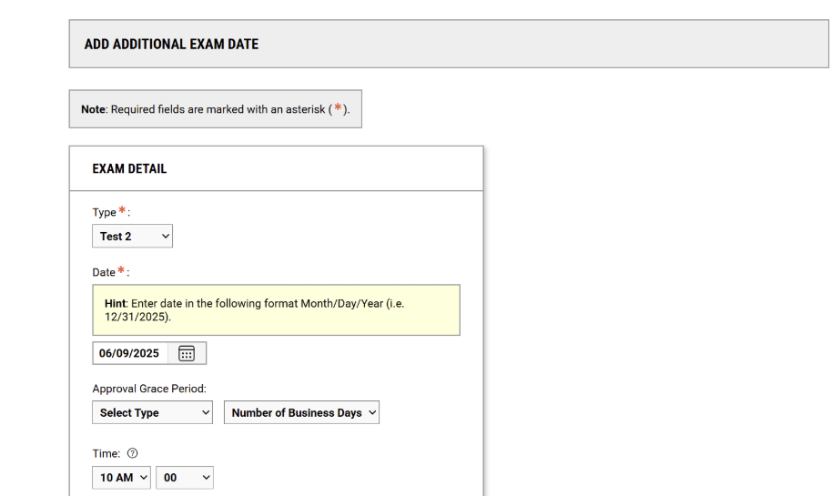
Once you have completed the testing agreement and added all additional exam dates/times, you will receive a confirmation email with a copy of your selections. You can also view or modify the testing agreement by accessing the Alternative Testing dashboard in your AIM Instructor Portal.

Slide 15
View or modify a previously-submitted testing agreement
You can view or modify a previously-submitted testing agreement by doing the following:
Access your AIM INSTRUCTOR PORTAL
Click the Alternative Testing link in the menu on the left-hand side.
Click the Testing Agreement (Required Instructor Questionnaire) link in the horizontal menu at the top of the page.
Click the View / Modify Testing Agreement (Required Instructor Questionnaire) link on the course and section to which you would like to review or update your selections.
If you make changes, click the Update and view Exam Dates button to save your selections.
If you want to add additional exam dates but do not want to make any changes to your testing agreement, you can click the List Exam Dates link at the top of the page and scroll to the Add Additional Exam Date section.

Slide 16
AIM allows you to copy selections from a testing agreement provided for one section to other sections of your course. To do this:
  Click Alternative Testing in the menu on the left-hand side.
  Using the horizontal menu access the AIM INSTRUCTOR PORTAL.
  Click the Testing Agreement (Required Instructor Questionnaire) link in the horizontal menu at the top of the page.
  Once you have completed the testing agreement and added all additional exam dates/times, you will receive a confirmation email with a copy of your selections. You can also view or modify the testing agreement by accessing the Alternative Testing dashboard in your AIM Instructor Portal.

Slide 17
Copy an Existing Test Agreement
AIM allows you to copy selections from a testing agreement provided for one section to other sections of your course. To do this:
  Horizontal menu Access the AIM INSTRUCTOR PORTAL
  Click Alternative Testing in the menu on the left-hand side
  Click the Testing Agreement (Required Instructor Questionnaire) link in the horizontal menu at the top of the page.
  Scroll to the course and section with a previously-completed testing agreement and click the View / Modify Testing Agreement (Required Instructor Questionnaire) link.
  Click the Copy Testing Agreement (Required Instructor Questionnaire) link at the top of the page
  Using the drop-down menu, select the course and section to which you want to apply the previously-completed testing agreement.

Slide 18
Copy an Existing Test Agreement
4. Click the Continue button.
5. On the following page, confirm your course information and the exam dates provided. You can either select existing dates to apply these to this additional section or provide custom dates. You can also indicate if you want the same exam file(s) provided for the additional section.
6. When finished, click the Copy Testing Agreement (Required Instructor Questionnaire) button to save your selections.
7. You may specify additional exam dates/times on the following page or navigate away from this page when finished. Your submission has been saved and can be viewed or modified by navigating to the Testing Agreement (Required Instructor Questionnaire) page.

Slide 19
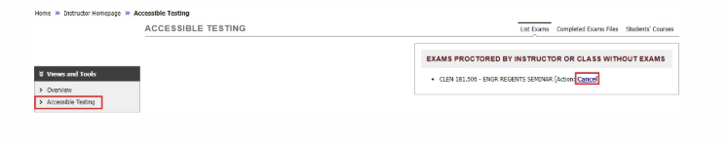
Made an Error?
If an instructor accidentally indicates they planned to proctor their own exams (or that the class has no exams), they can clear (cancel) that entry and start over.
Log into the AIM INSTRUCTOR PORTAL and review the “Accessible Testing” page.
At the top right of the page is a box titled “Exams Proctored by Instructor or Class with out Exams”.
Click “Cancel” and the Testing Agreement will reopen for that course/section.

Slide 20
Uploading an Exam in AIM
Instructors have multiple options for providing their exams to the Testing Center, such as dropping them off in person etc., however the most efficient way would be to upload them to AIM Portal. Please provide exams the day before by 4pm (noon on Fridays for Monday exams).
In order to upload an exam in AIM:
Navigate to “List Exam Requests” by clicking on “Accessible Testing” and then “List Exams”.
  Note: A student may be on the list multiple times for each exam request they have made.
Select from the drop down list “Upload File to Exam(s)” exam.
Click the checkbox next to the exam you are uploading a file for.
Click “Confirm Your Selections”.

Slide 21
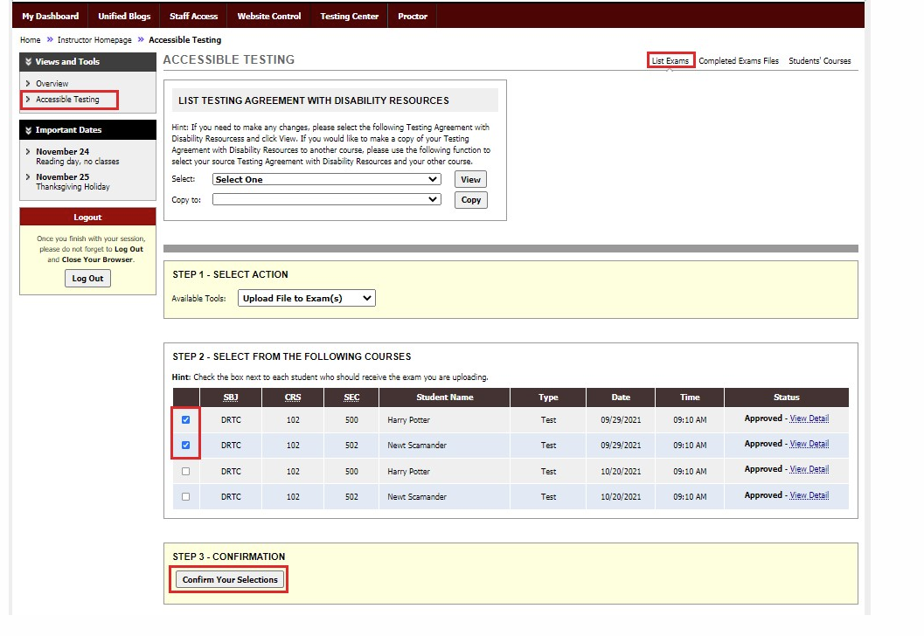

Slide 22
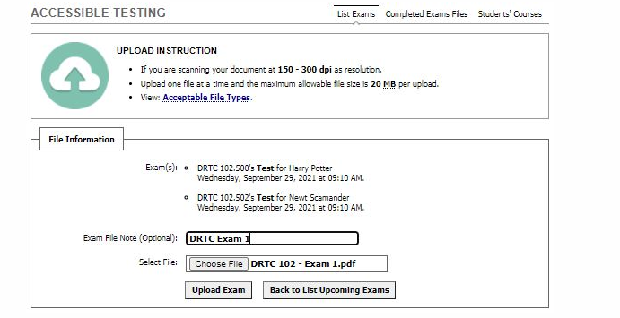
This will take you to the upload page. Click choose file, then Browse for the file you wish to upload. Optionally, you can add an Exam file note. Please make sure that the file size is no bigger than 1MB.
Select Upload Exam.
Once uploaded you will see the Status column Updated on the list of exams

Slide 23
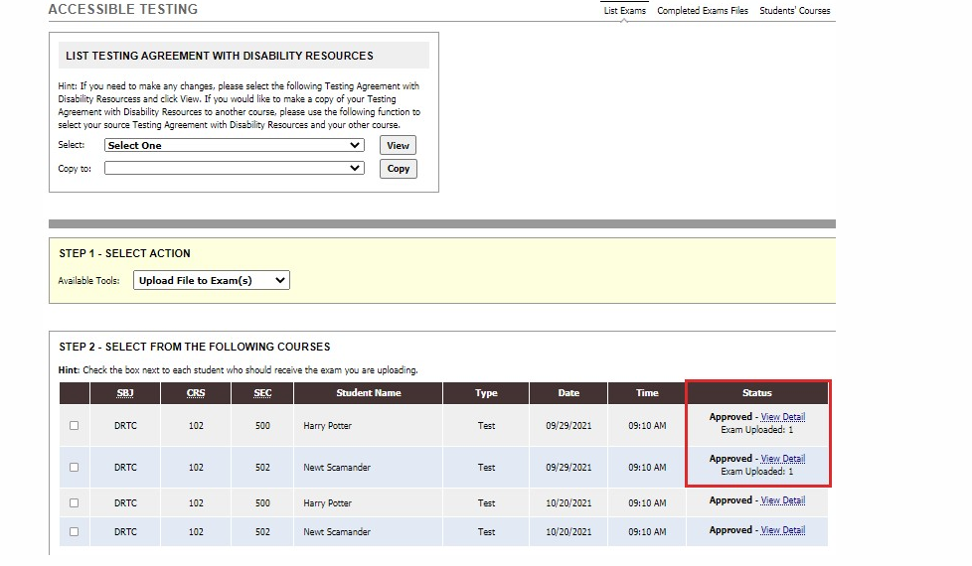

Slide 24
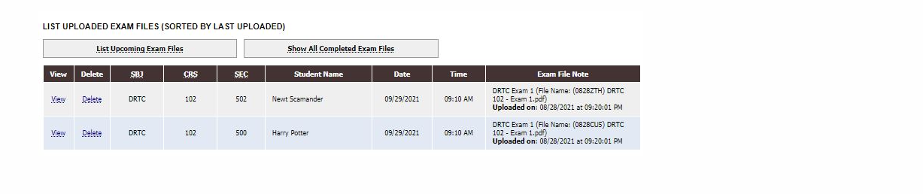
8. At the bottom of the List Exams page there is a summary of all uploaded exams with options to view, delete and a link to access the Completed Exams page.

Slide 25
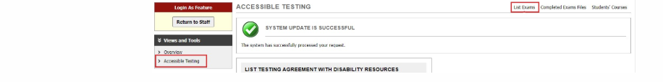
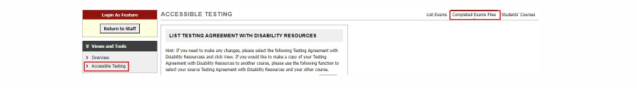
Retrieving a Completed Exam from AIM
One of the return options instructors can request is to have their exam scanned and uploaded to the AIM portal after the exam is completed. Instructors should receive an email when the exam file(s) are uploaded which includes these instructions:
1. Logon to the AIM INSTRUCTOR PORTAL and navigate to Accessible Testing, this will automatically bring you to “List Exams”.
2. Navigate to “Completed Exam Files” by clicking the link at the top right of the page. This will take you to a bookmarked link at the bottom of the List Exams page.

Slide 26
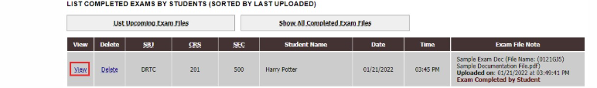
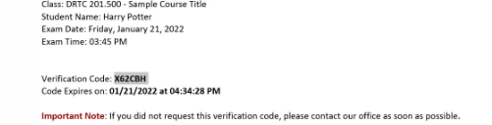
Alternatively, to see completed exam files that have been uploaded to AIM, scroll to the bottom of the List Exams page, click “Show All Completed Exam files“.
3. Navigate to the exam file you wish to view and click “View”
4. A security code will be emailed to the instructor(s) of record.NOTE: The verification code expires in 20 minutes. If the code expires before you download the file, you can go back in the portal and click on View again to request a new code.

Slide 27
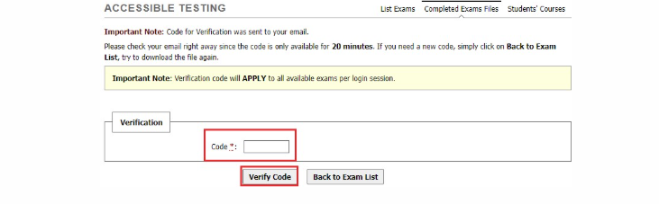
5. Enter the security code in the field provided.
6. You may then download your exam file.

Slide 28
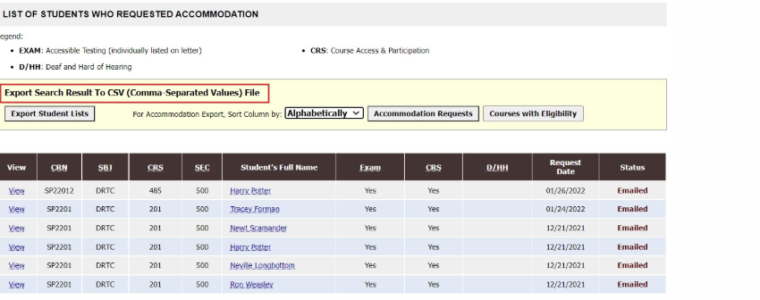
Exporting Lists out of AIM
Instructors also have the ability to export some lists/reports out of the AIM Instructor portal.
Download a List of Students
Log in to the AIM INSTRUCTOR PORTAL
On the Instructor Authentication Page review reminders in the yellow box and then click “Continue to View Student Accommodations”. This will take you to the Overview page.
On the bottom lower half of the Overview page there will be white box that says “Export Search Result To CSV (Comma-Separated Values) File.

Slide 29
Export Options:
  a. Export Student Lists: Student Last Name, Student First Name, Email, UIN, Primary Advisor and columns for each specific accommodation
    - Does not include course information.
  b. Accommodation Requests: Student Last Name, Student First Name, Email, UIN, Primary Advisor, CRN, Subject, course, section, date of initial request, date of last update and columns for accommodation groups.
    Does note include specific accommodations (i.e. extended time value)
  c. Courses with Eligibility: Student Last Name, Student First Name, Email, UIN, Primary Advisor, CRN, Subject, course, section, date of initial request, date of last update and columns for each specific accommodation.
5. Your file will be automatically downloaded.

Slide 30
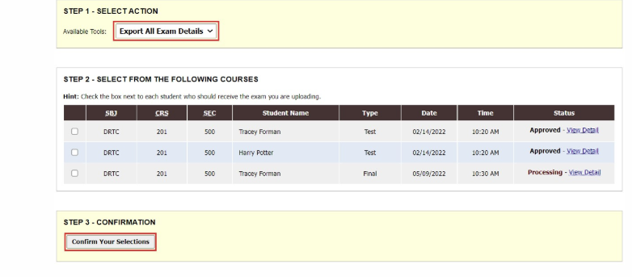
View and Download a List of Exams
Logon to the AIM INSTRUCTOR PORTAL and navigate to Accessible Testing, this will automatically bring you to “List Exams”
Scroll down to Step 1 – Select Action and change Available Tools to ” Export All Exam Details”
NOTE: For this action (export all exam details), you do not need to complete Step 2
Under Step 3 – Confirmation click “Confirm your Selection”
AIM will export a summary list of all exams on your list including the following fields: Student Name, UIN, Email, Subject, Course, Section, Date, Time Start, Time End, Approved Accommodations.

Slide 31
Need Assistance?
By Appointment
Faculty/Instructors:
  Schedule a 15 minute appointment with a ODS staff member to review exam scheduling questions (the Testing Agreement and Instructor Portal).
  Schedule a 15 minute appointment with the student’s assigned Case Manager (CM) or the first available CM for questions about the accommodation letters or specific accommodation requests.
    Call 504-520-7607 or send a list of availability for the next few days to disabilityservices@xula.edu.
    Thank You!
    ???

