Slide 1
Financial Aid Town Hall

Slide 2
Agenda
Welcome and Introduction of Panelists
Financial Aid Terminology
Financial Aid Offers
Merit Scholarships for Continuing Students/TOPS
Important Next Steps
Fiscal Clearance (Understanding your Fee Bill/As
Payment Plans
Q&A

Slide 3
Financial Aid

Slide 4
Two Types of Financial Aid Notifications
Official Financial Aid Offer as a result of your valid FAFSA
Estimated Eligibility Notification awaiting completion of Verification

Slide 5
Official Financial Aid Offer
Official Financial Aid Offer Notifications are generated twice a week
Sent to your XULA email

Slide 6
Estimated Eligibility Notification
Estimated Eligibility Notifications are generated once a week
Sent to your XULA email

Slide 7
What Does The Fin Aid Offer Notification Look Like?
2020 - 2021 Financial Aid Offer Notification
Dear ,
Greetings from the Office of Student Financial Aid!
Your 2020 - 2021 Financial Aid Offer is available on Banner Web. You have either been initially offered or your existing offer has been adjusted. You can view and/or accept your financial aid offer by logging onto www.xula.edu. Therefore, we encourage you to read this letter carefully and in its entirety to understand the financial process as well as important terminology and steps to accept/decline your offer.
I. Terminology
Cost of Attendance (Budget): An estimated cost for educational related expenses.
Expected Family Contribution (EFC): Your EFC is a measure of your family’s financial strength and is calculated according to a formula established by law. The EFC is used to determine the amount of financial aid that you are eligible for.
Direct Cost: The amount/expenses paid directly to the University for tuition/fees and housing.
Indirect Cost: Other cost/expenses paid to fund the educational expenses.
Resource(s): Other expected financial aid/assistance the student is scheduled to receive.

Slide 8
What Does The Fin Aid Offer Look Like?
Below is an EXAMPLE of a Budget/Cost of Attendance for an undergraduate student:
Note: Students living on-campus in the dormitory will have an estimated expense of $8,800 added to their direct cost.
BUDGET COMPONENTS | XAVIER (Direct Cost) Yearly | ESTIMATED PERSONAL (In-Direct Cost) Yearly | TOTAL
Tuition | $ 21,954.00 | 0.00 | $ 21,954.00
Fees | 2,394.00 | 0.00 | 2,394.00
Books and Supplies | 0.00 | 1,300.00 | 1,300.00
Personal Expenses | 0.00 | 2,080.00 | 2,080.00
Transportation | 0.00 | 2,800.00 | 2,800.00
Total | $ 24,348.00 | $ 6,180.00 | $ 30,528.00

Slide 9
What Does The Fin Aid Offer Look Like?
II. To accept your offer, please follow these steps
Go to Xavier University's website: www.xula.edu.
Click Banner Web, click Log into Secure Area.
Enter your User ID and your PIN (the month, the date, and last 2 digits of your birth year)
Select Student and Financial Aid.
Click on Virtual Financial Aid Office, then on Electronic Aid offer.
Click on Aid offered by Aid Year, and select the Aid year July 2020 - June 2021 from the drop menu, the click "Submit".
To accept or decline your offers, click on the "Accept Aid offer" tab, make sure you accept or decline ALL loans or work study offer (if applicable), prior to clicking on the "Submit Decision" button.

Slide 10
Important Terminologies
Cost of Attendance (Budget): An estimated cost for educational related expenses. Helps to determine maximum aid eligibility.
Direct Costs: The amount/expenses paid directly to the University for tuition/fees and campus housing.
Indirect Cost: Other cost/expenses paid to fund the educational expenses which includes, but not limited to living expenses.
Expected Family Contribution (EFC): Your Expected Family Contribution (EFC) is a measure of your family’s financial strength and is calculated by a formula established by the Department of Education. It is one of the components used to determine how much financial aid you are eligible to receive.
Resource(s): Other expected financial aid/assistance the student is scheduled to receive i.e. veteran benefits, external scholarships and grants.

Slide 11
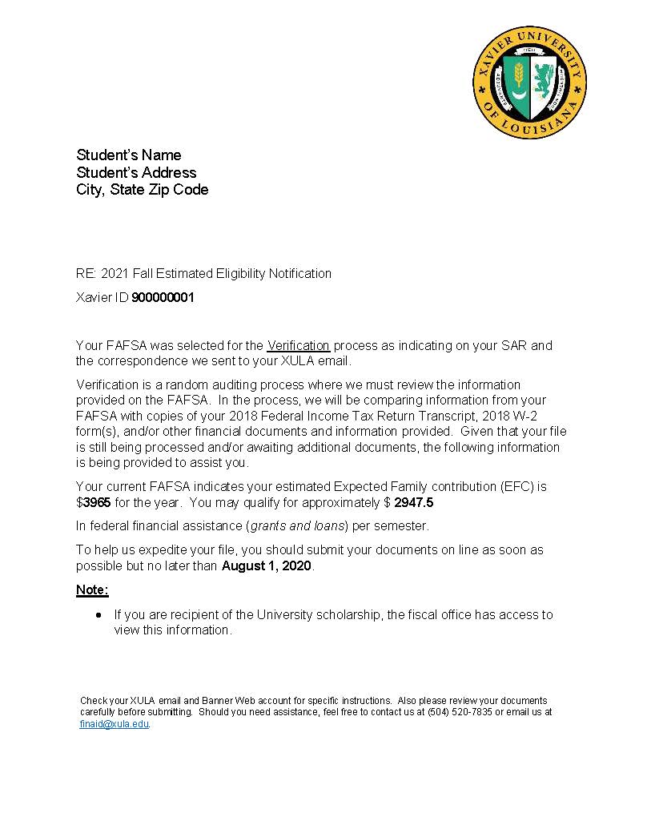
Estimated Eligibility Notification
Pell
Direct Loans for Students
*Scholarship award not included, but can be viewed by Fiscal Services/Student Accounts Office.

Slide 12
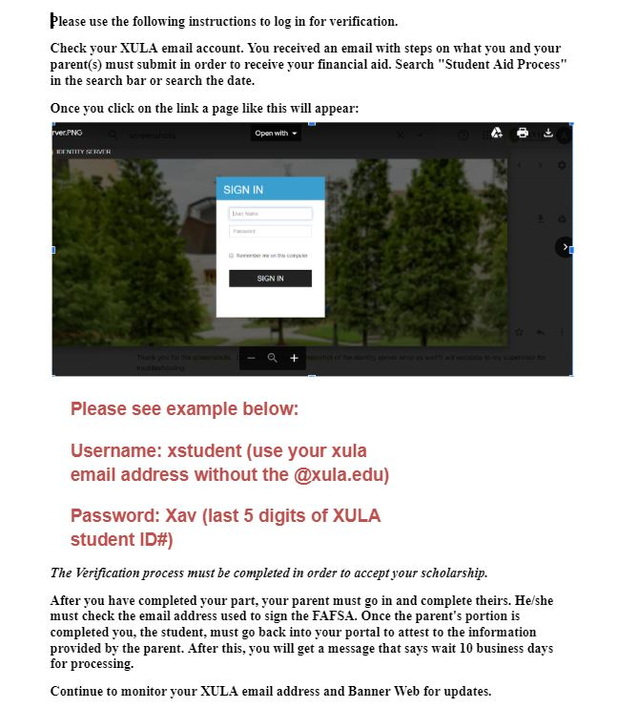
Estimated Eligibility Notification (Awaiting Completion of Verification)

Slide 13
Reasons You Have Not Received an Estimated Eligibility Notification
Not Filed a FAFSA
Not Fully Admitted
FAFSA Not Signed (Rejected SAR)
Didn’t include XULA Code 002032
Not meeting Satisfactory Academic Progress (SAP)

Slide 14
How to Accept/Decline/Adjust Financial Aid Offer

Slide 15
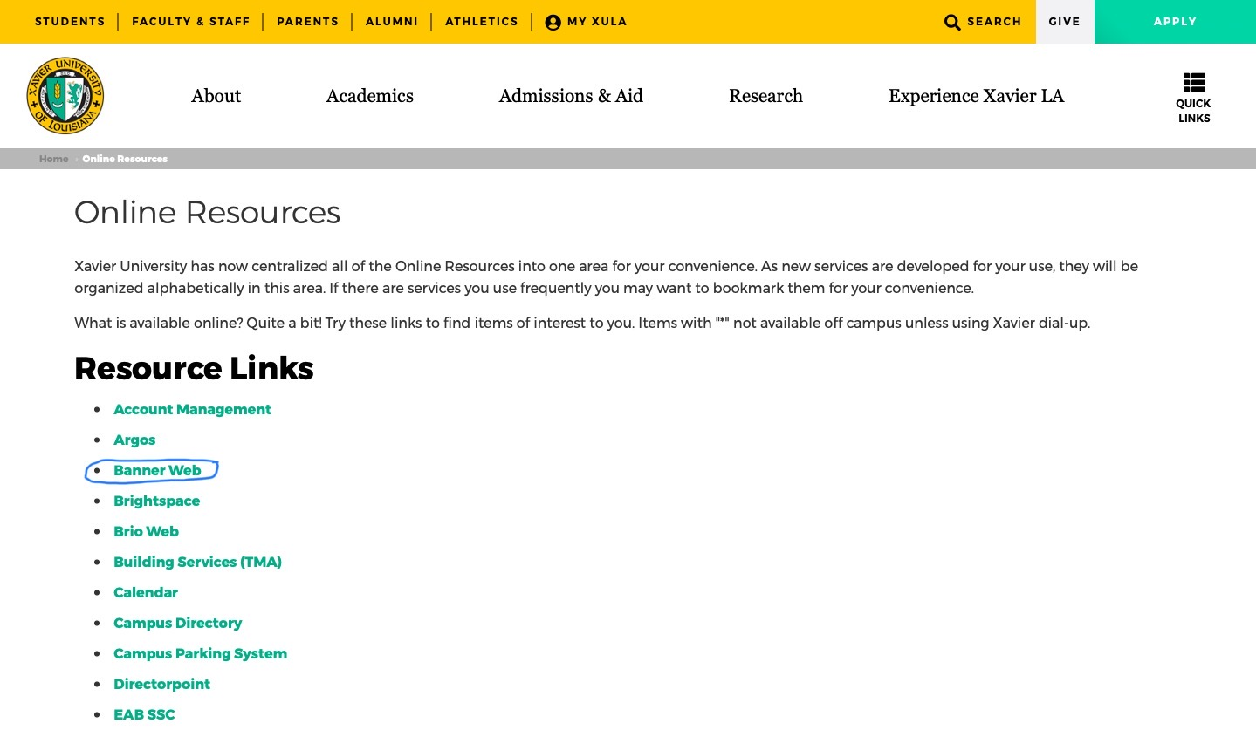
How to Accept/Decline Offer?
Banner Web

Slide 16
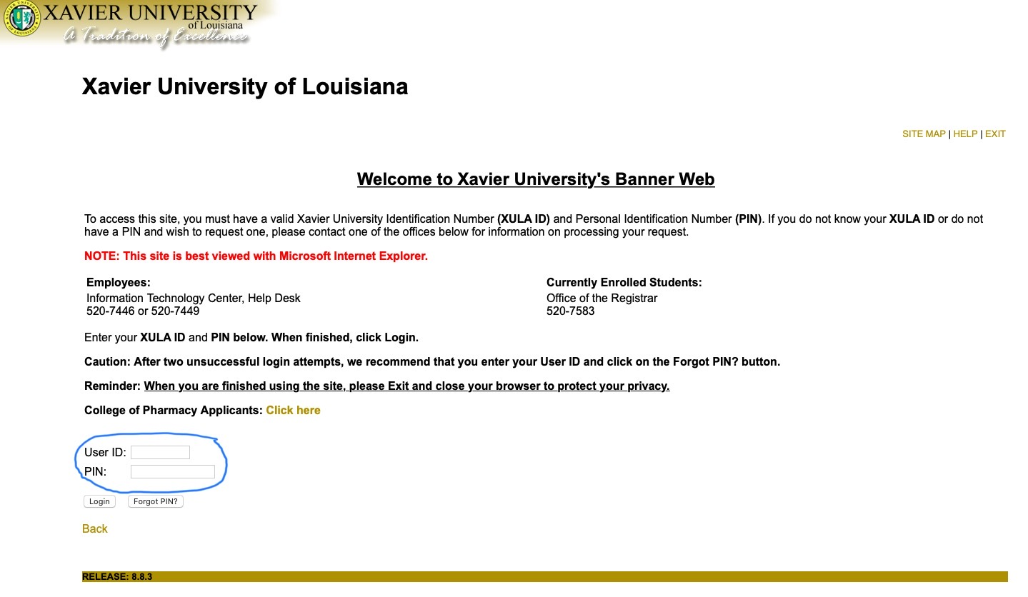
How to Accept/Decline Offer?
Banner Web
Banner Web Log In

Slide 17
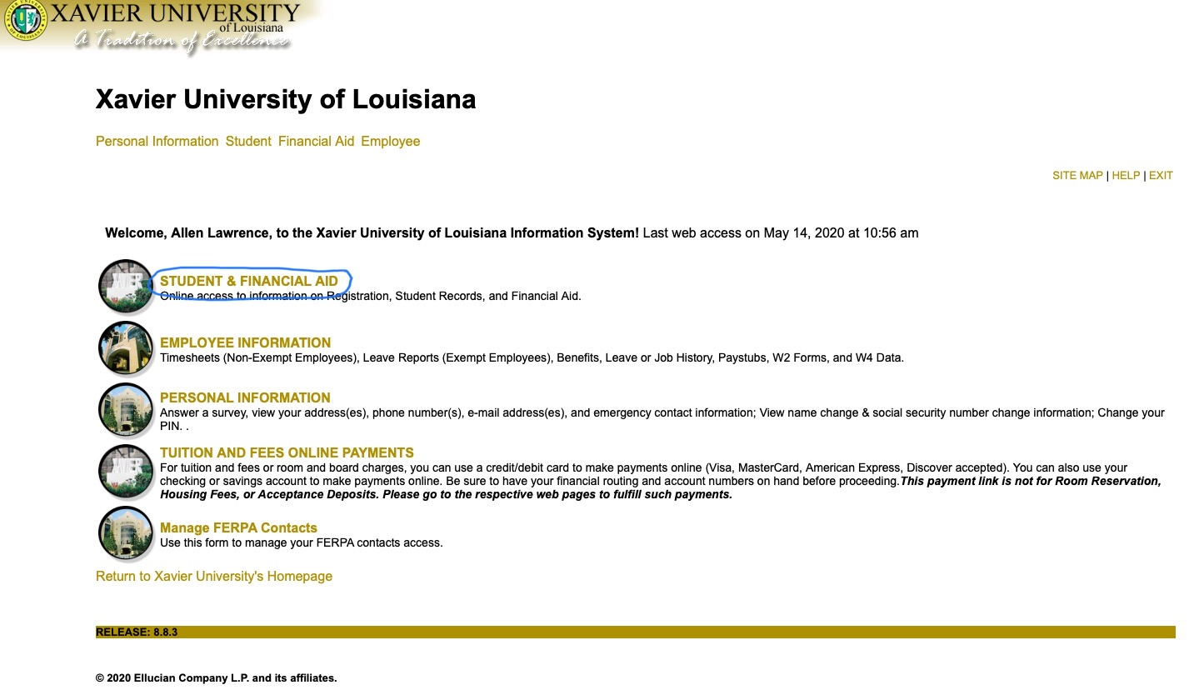
Student & Financial Aid

Slide 18
Banner Web
Virtual Financial Aid Office

Slide 19
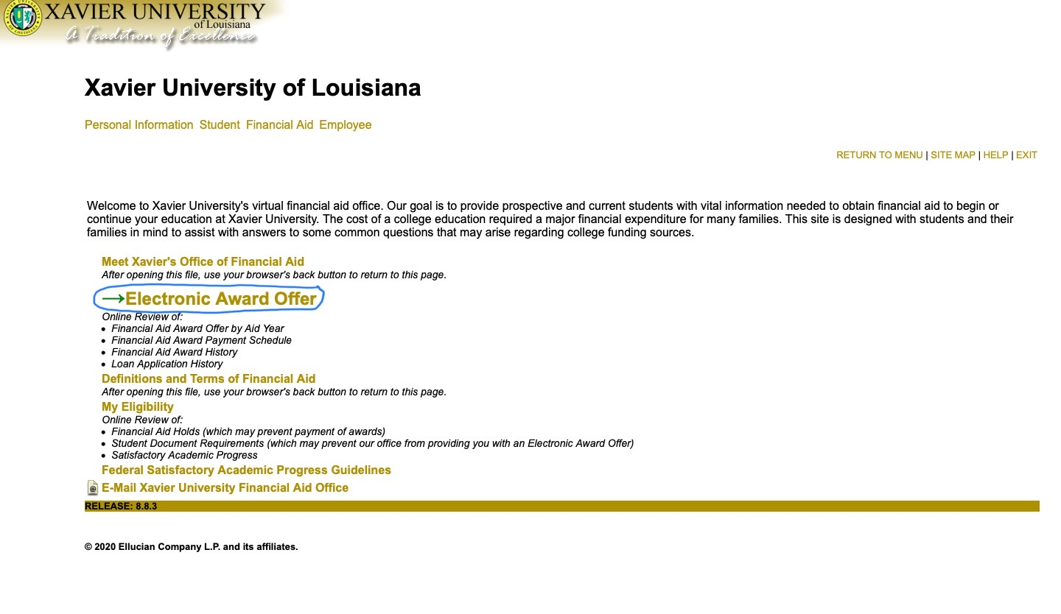
Electronic Award Offer

Slide 20
Electronic Aid Offer by Aid Year

Slide 21
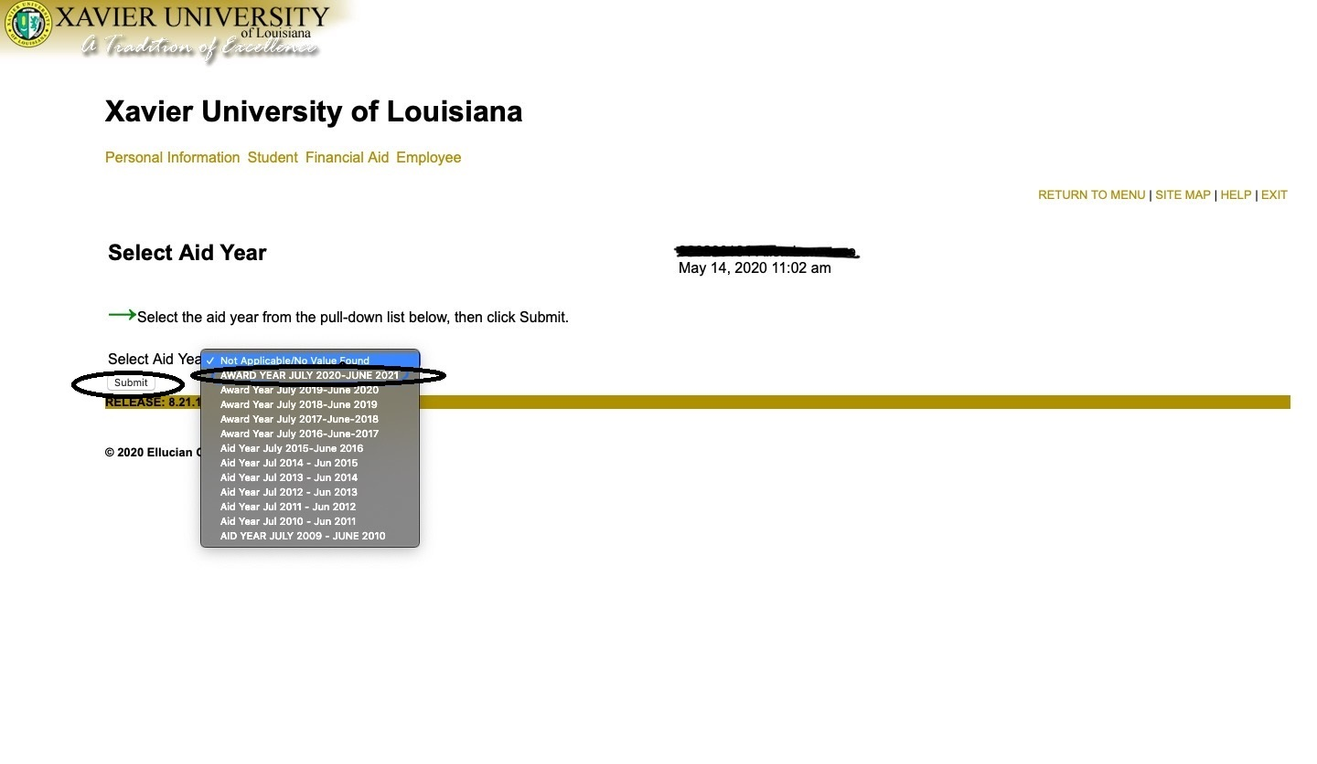
Select Aid Year
July 2020- June 2021

Slide 22
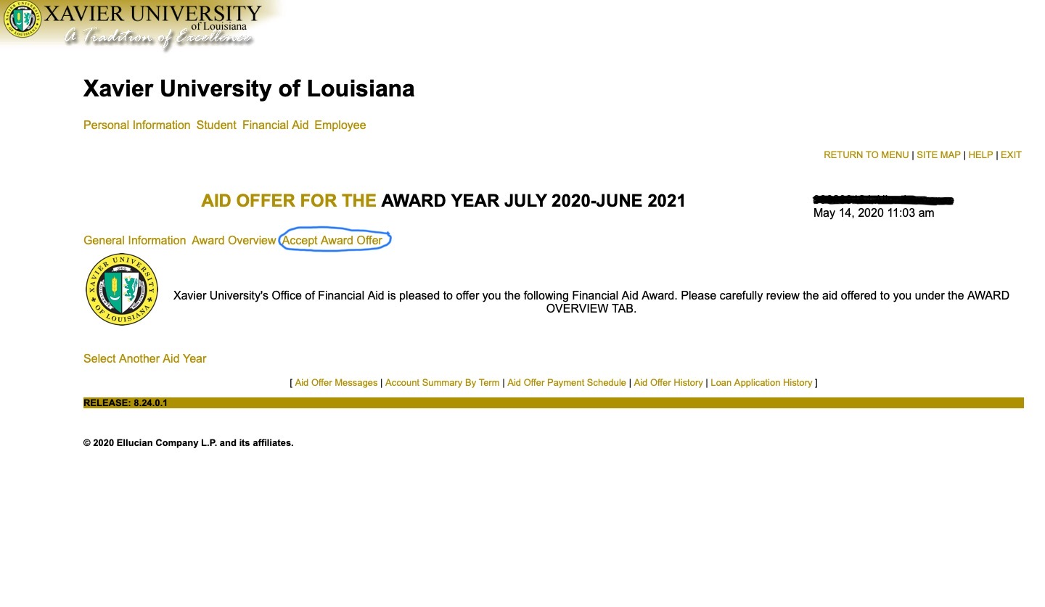
Accept Award Offer
**Parent Plus Loans can not be accepted/declined on Banner Web**

Slide 23
Accept/Adjust/Decline Award & Submit Decision
Select ACCEPT or DECLINE from the drop down list for each Fund.
To ADJUST Aid: You may accept a partial amount by selecting ACCEPT and entering the amount in the Accept Partial Amount field.
Please be aware if you reduce your aid, the reduction amount will be divided evenly between each semester. If you would like the reduction amount to be uneven per semester, please email your financial aid counselor.
Review your decisions.
You select “submit your decision”.

Slide 24
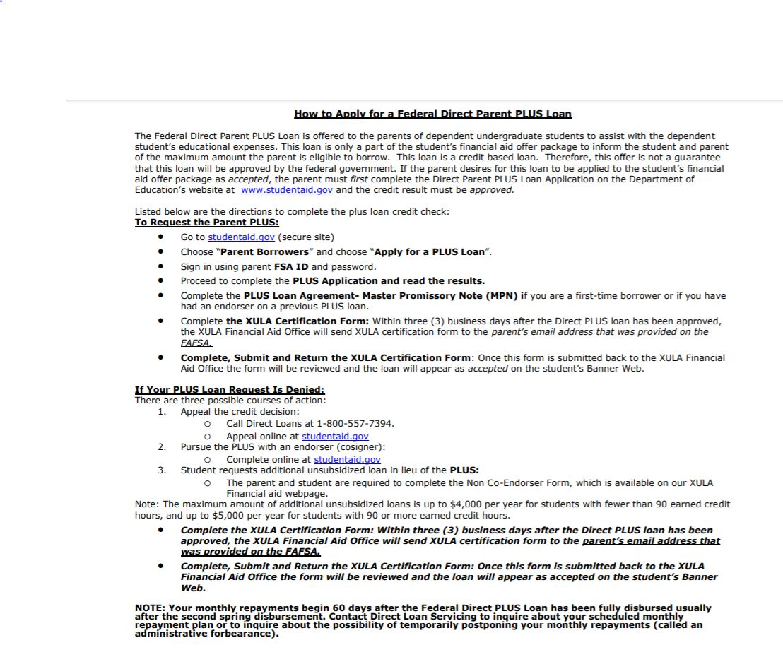
Parent Plus Loan Can Not Be Accepted on Banner Web

Slide 25
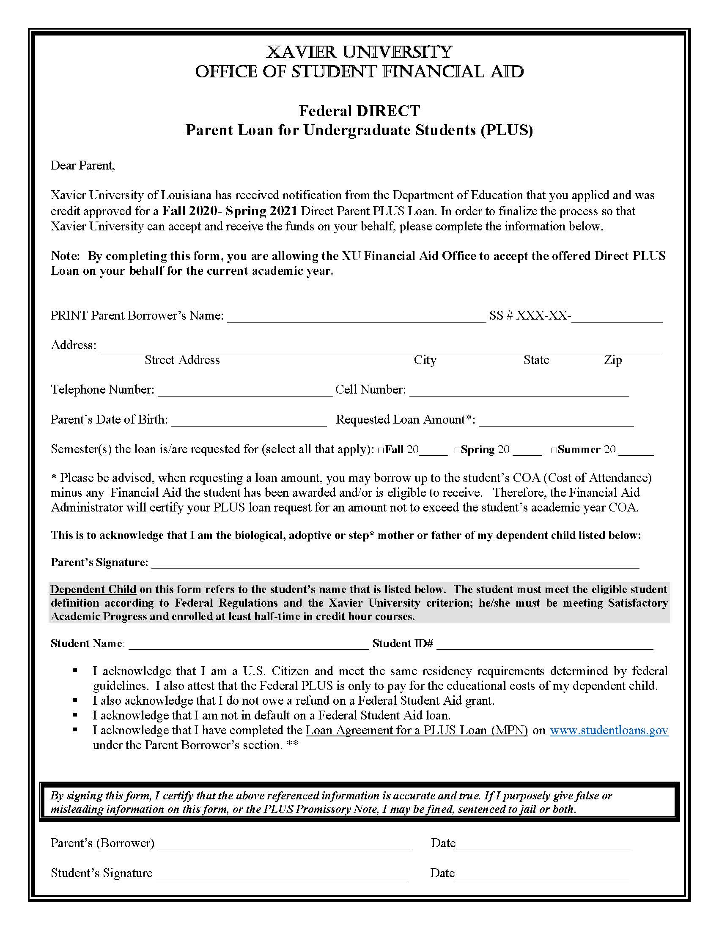
Parent Plus Loan XULA Certification Form

Slide 26
Scholarships

Slide 27
Scholarships
Continuing Students - Merit Scholarship Update
FAFSA Required
Direct cost adjustments
Board of Trustees Scholars - Housing
Visit Scholarship Search Database for Outside Scholarship Opportunities
https://www.xula.edu/scholarships

Slide 28
Fiscal Clearance

Slide 29
Fiscal Clearance Process and Deadlines
If you have a zero or credit balance you will automatically be Fiscally Cleared.
If your financial aid (including scholarships) does not cover the entire cost of tuition, fees and housing (if applicable) you will have a “minimum payment required”.
Please submit your required minimum payment to be Fiscally Cleared. Payments can be made online by logging into your Banner Web account or by mail:
Xavier University of Louisiana
Office of Student Accounts
1 Drexel Drive, Box 121
New Orleans, LA 70125
Required payment (1/2 due to the Office of Student Accounts) by the following dates:
July 31, 2020 – Fall 2020
Fall 2020 Registration is August 13 &14, 2020.
Fall 2020 Late Registration is August 17 – 19, 2020.

Slide 30
Fiscal Clearance Process and Deadlines

Slide 31
Fiscal Clearance Process and Deadlines

Slide 32
Fiscal Clearance Process and Deadlines

Slide 33
Fiscal Clearance Process and Deadlines

Slide 34
Fiscal Clearance Process and Deadlines

Slide 35
Fiscal Clearance Process and Deadlines

Slide 36
Payment Plan Process
Fall 2020 Student Installment Loan Payment Plan (known as the Payment Plan)
Students who have a remaining student account balance after applying their financial aid and scholarship award can either pay their entire remaining balance or enroll in the Xavier Student Installment Loan Payment Plan that is processed through CASHNet.
Access to CASHNet is provided by clicking “Tuition and Fees Online Payments” in Banner Web.
DESCRIPTION | EARLY REGISTRATION DUE DATE | ON-SITE REGISTRATION (50%) PAYMENT DUE DATE | 2nd PAYMENT DUE DATE | FINAL PAYMENT DUE DATE
FALL 2020 | Due on or before July 31, 2020 | Due on or before August 14, 2020 | ½ due on or before September 30, 2020 | Due on or before October 30, 2020
SPRING 2021 | Due on or before December 18, 2020 | Due on or before January 8, 2021 | ½ due on or before February 26, 2021 | Due on or before March 31, 2021

Slide 37
Payment Plan Process

Slide 38
Fiscal Clearance Process and Deadlines

Slide 39
Payment Plan Process

Slide 40
Payment Plan Process

Slide 41
Payment Plan Process

Slide 42
Payment Plan Process

Slide 43
Payment Plan-Questions
Email: paymentplan@xula.edu
Voicemail: (504) 520-5710

Slide 44
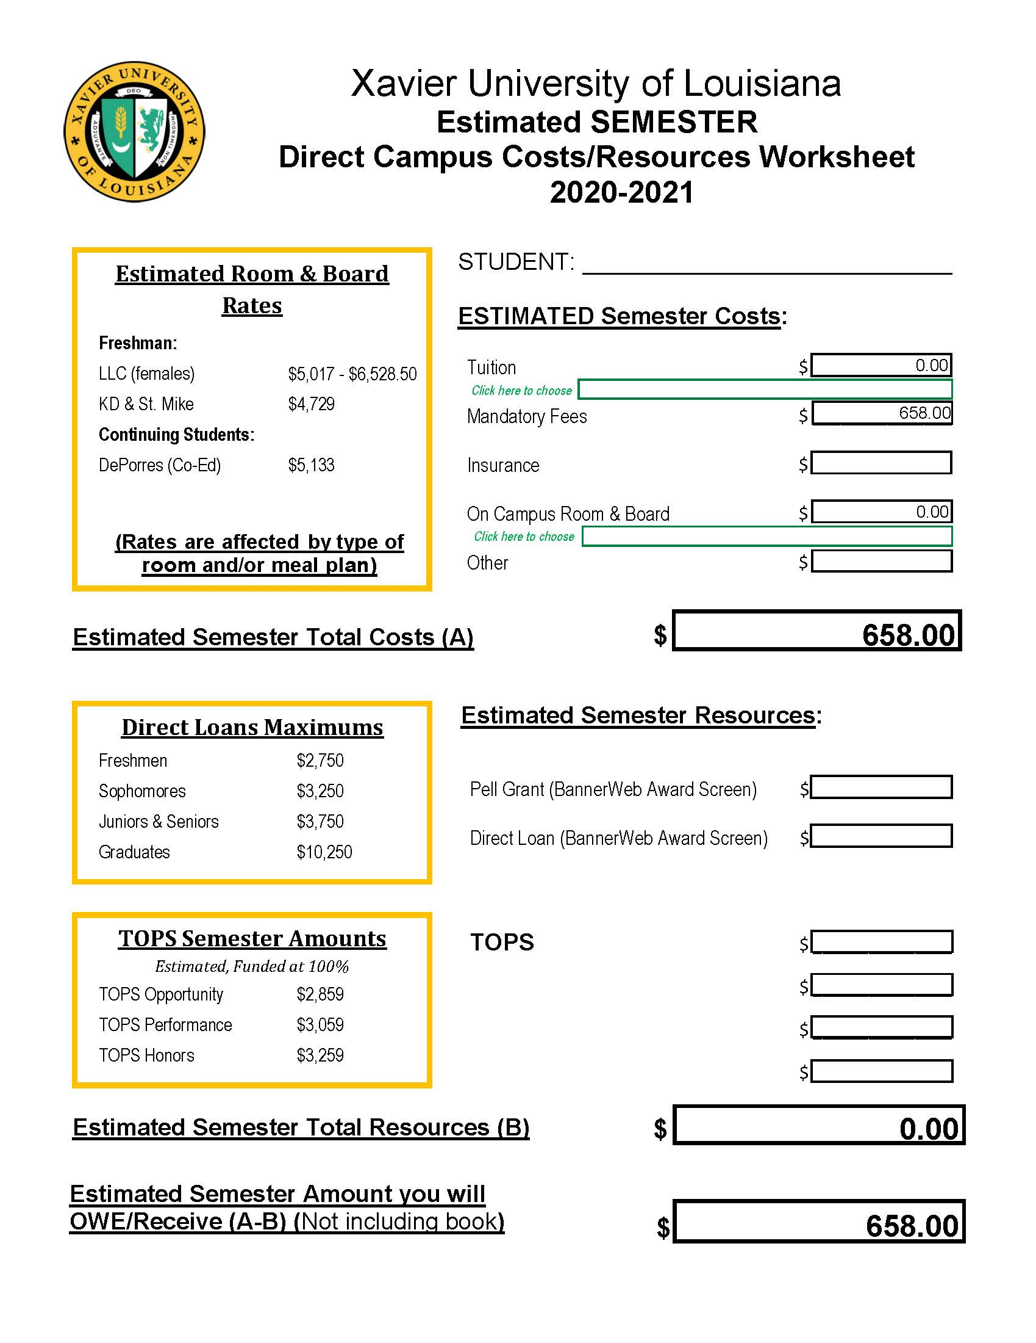
Estimated Cost Calculator
https://www.xula.edu/financialaid
Under Calculators
Select Estimated Semester Cost

Slide 45
Special Circumstances Need-Based Award

Slide 46
Special Circumstances Need-Based Award
To assist students who have special financial circumstances.
To qualify, students must:
Have a valid 2020-2021 FAFSA on file
Complete an application
Have recently incurred a qualifying expense
Qualifying expenses include:
Child/Elderly care
Medical/Dental expenses
Educational expenses for other dependents
Loss of employment or income
Students must submit supporting documentation for each expense in order to be considered for the grant. Application and inquiries should be sent to spcnbgrant@xula.edu

Slide 47
Important Contact Information
Special Circumstances Need-Based Grant – spcnbgrant@xula.edu
Satisfactory Academic Progress (SAP) Appeal sapapp@xula.edu
Financial Aid – finaid@xula.edu
Financial Aid Website-www.xula.edu/financialaid
Student Accounts – stuaccts@xula.edu
Admissions – admissions@xula.edu
Financial Aid’s Twitter account – @XUFinancialAid

Slide 48
Questions?

