Slide 1
TMA Systems
2015 User Conference
April 15, 2015
“The Long Road to Recovery”
Presented by: Marion B. Bracy
Vice President of Facility Planning and Management
Xavier University of Louisiana

Slide 2

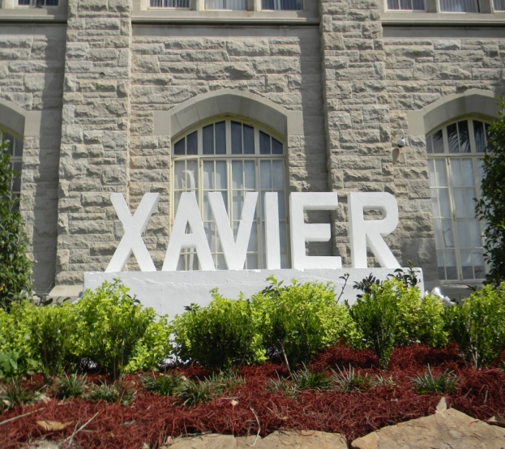
Xavier university of Louisiana
The Long Road to Recovery
9 Years 7 Months 14 Days
And We’re Not Done Yet!

Slide 3
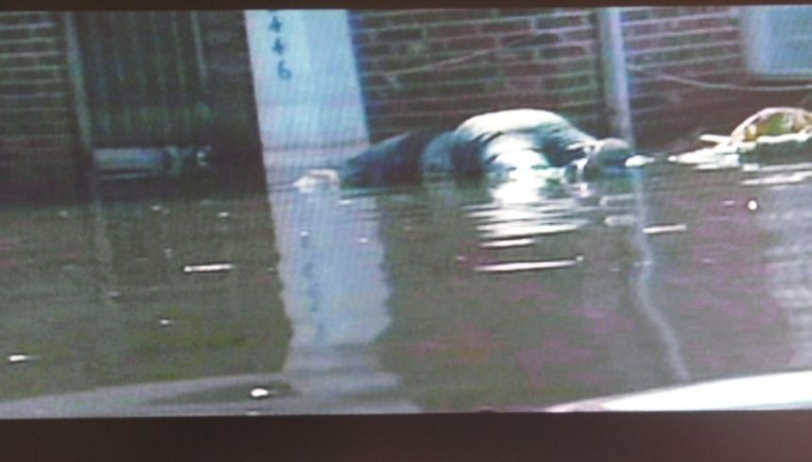
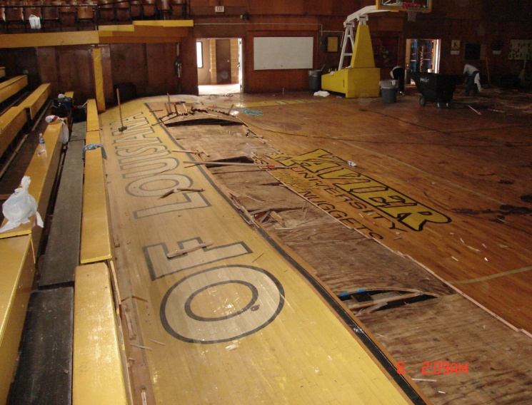
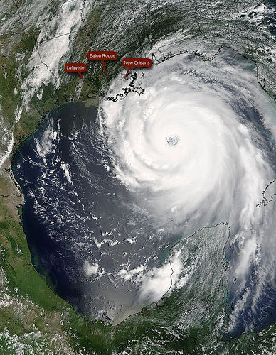
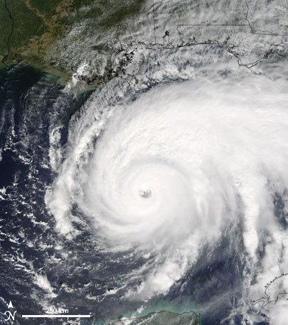
Hurricane Katrina
August 29, 2005
Hurricane Rita
September 24, 2005

Slide 4
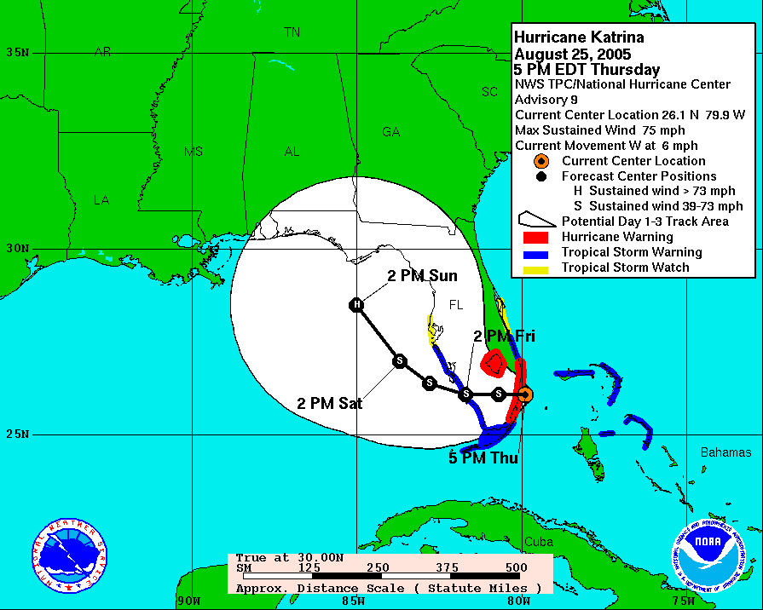
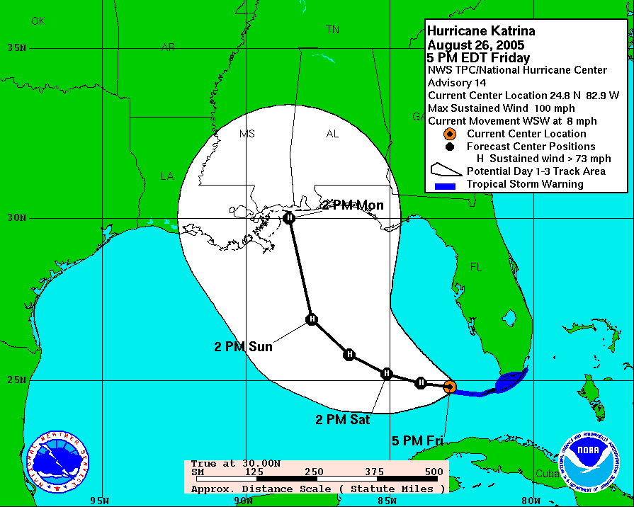
Projected Path of Hurricane Katrina,
August 2005
Thursday, August 25th, projected landfall between Mobile, Ala. and Pensacola, Fla. (150+ miles east of New Orleans)
Friday, August 26th, projected landfall at the Ala./Miss. state line (over 100 miles east of New Orleans)

Slide 5
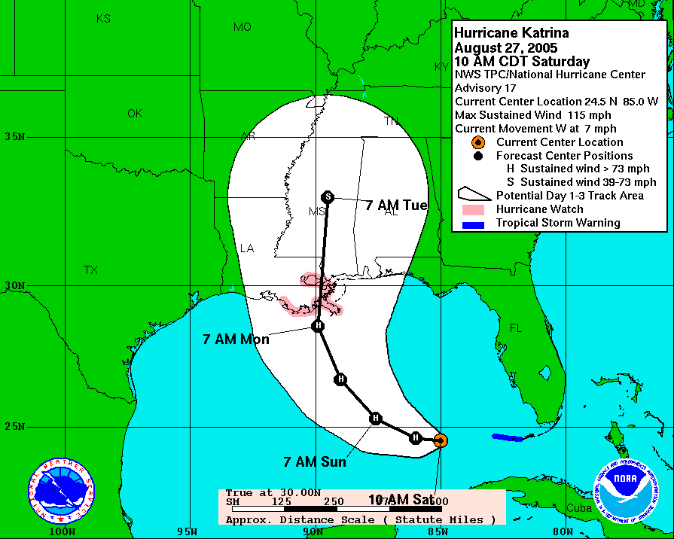
Projected Path of Hurricane Katrina, August 2005
On Saturday, August 27th, projected landfall – New Orleans, Louisiana – 7:00 A.M. on August 29, 2005.
We had been through storms before and we were ready for this one…

Slide 6
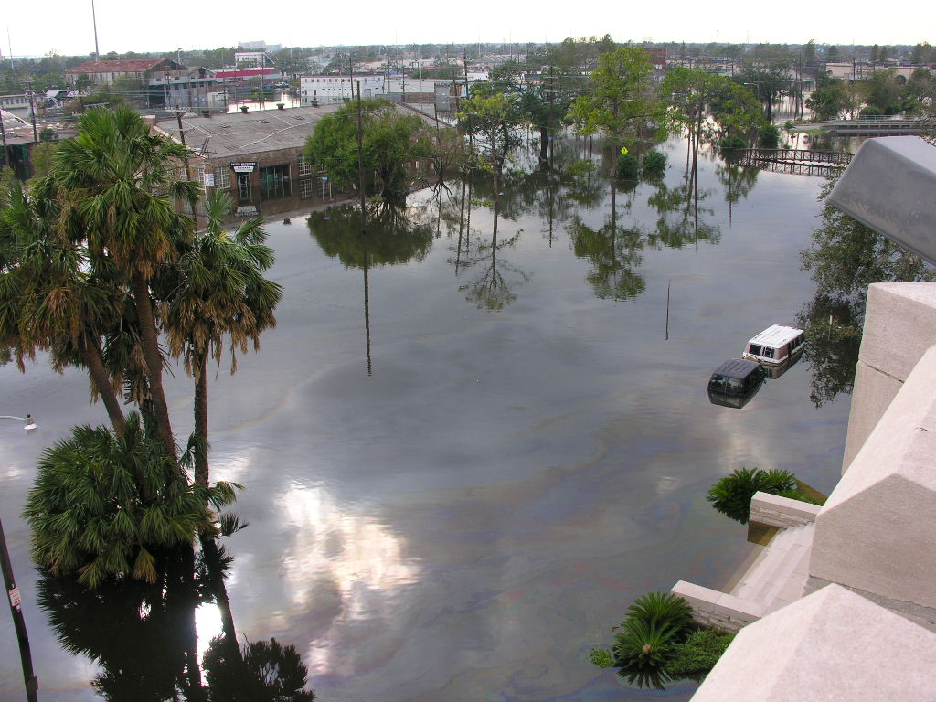
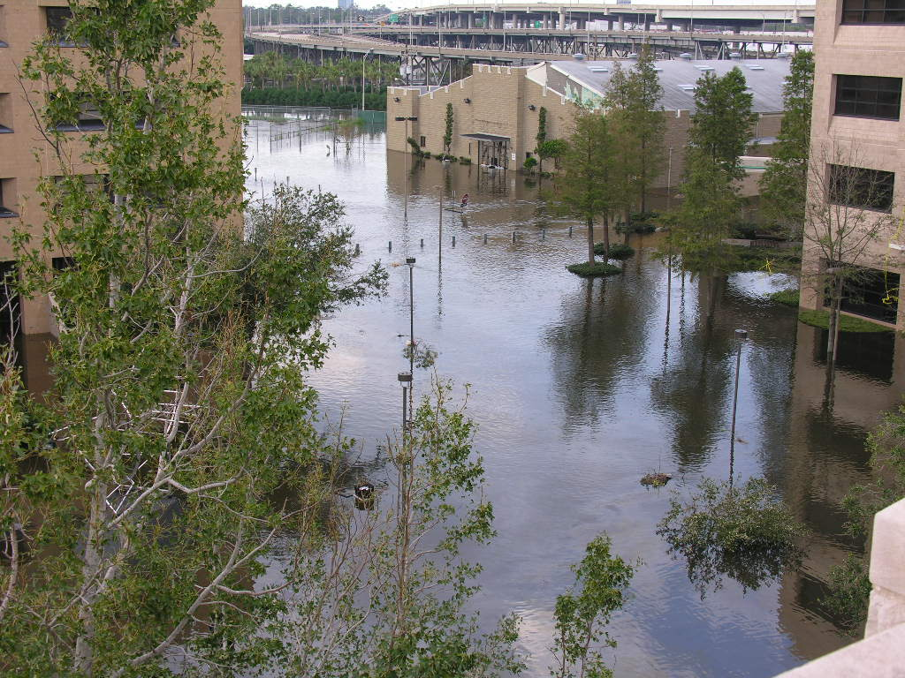
Hurricane Katrina facts:
…Until the storm hit
Over one million Gulf Coast residents were displaced
Death total 1,836 (1,577 in Louisiana and 238 in Mississippi)
80% of New Orleans was under water for weeks and without power for months
$75 billion in physical damage, $150 billion economic impact
90,000 sq. miles were affected – not a local event
More than 70 countries made monetary donations – Kuwait, Qatar, China, and India were among the largest contributions
Washington Ave. Canal
August 30, 2005
Science Quad During Katrina

Slide 7
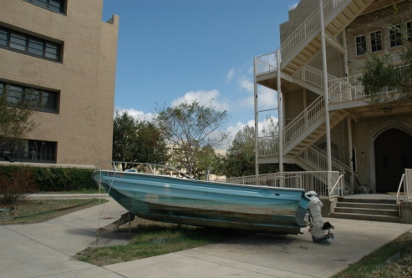
If a Picture is worth a 1,000 words…
September 2005
October 2005
October 2005

Slide 8
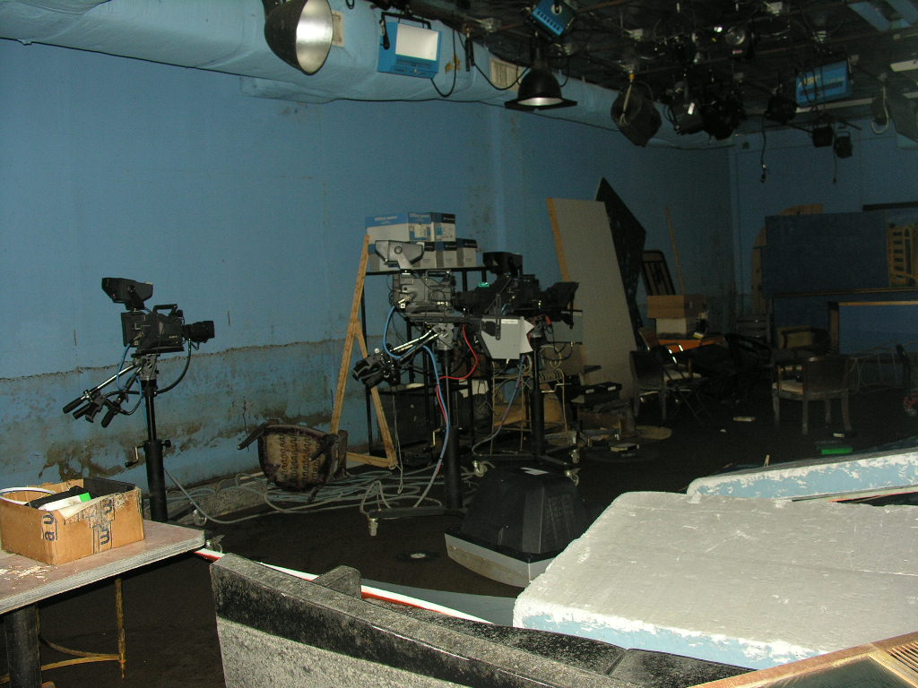
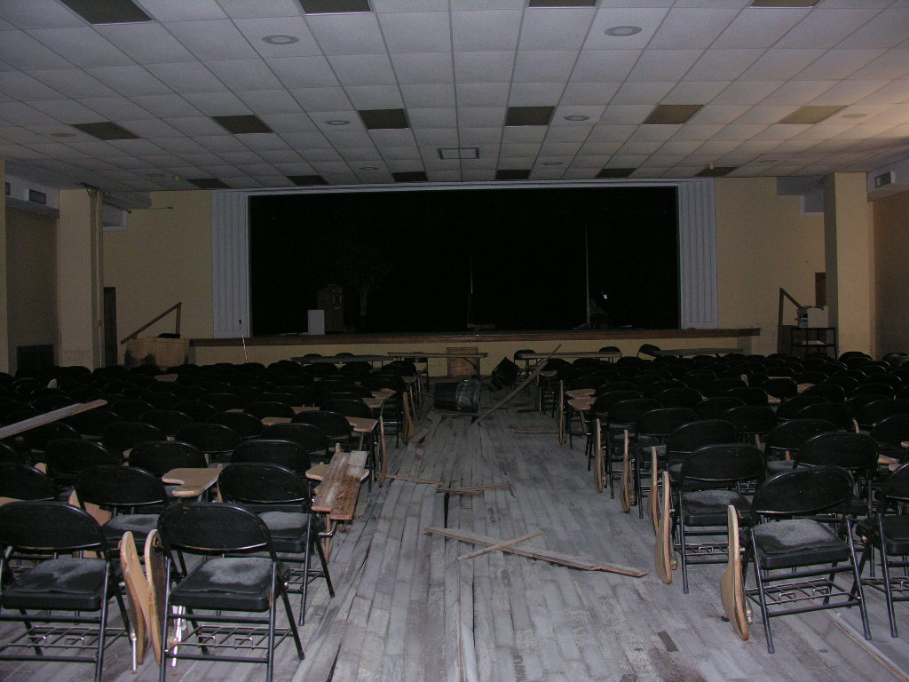
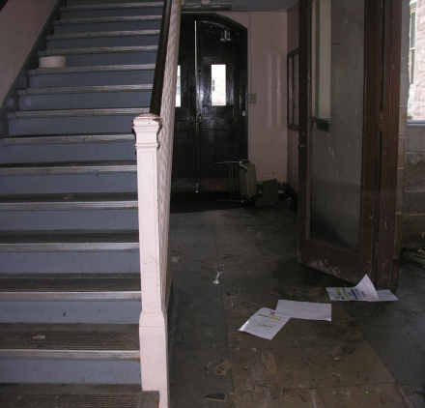
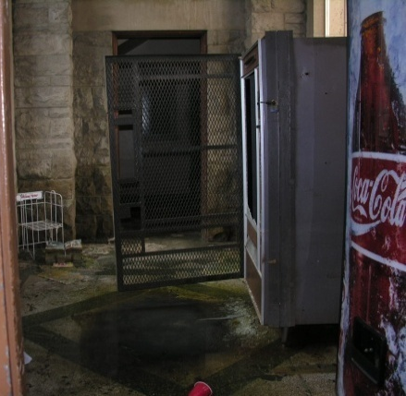
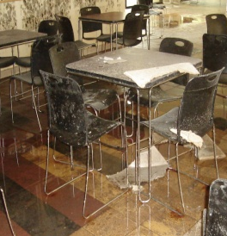
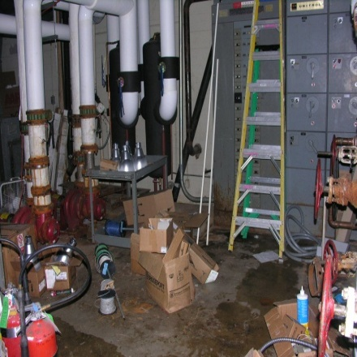
How many pictures are worth $1 million or $250 million?
Mass Communications
Auditorium
Original Academic Building
Cafeteria
Central Plant

Slide 9
Lessons Learned
Be Proactive
Begin with the End in Mind
Put First Things First
Think Win-Win
Seek First to Understand, and then to be Understood
Synergize
Sharpen the Saw
7 Habits of Highly Effective People

Slide 10
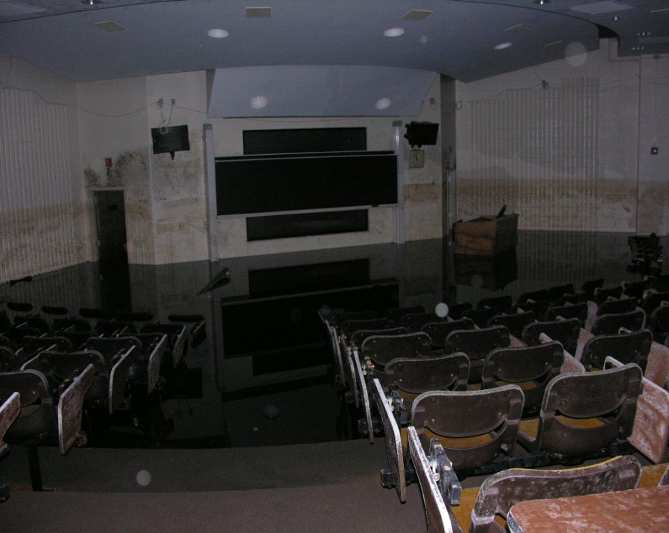
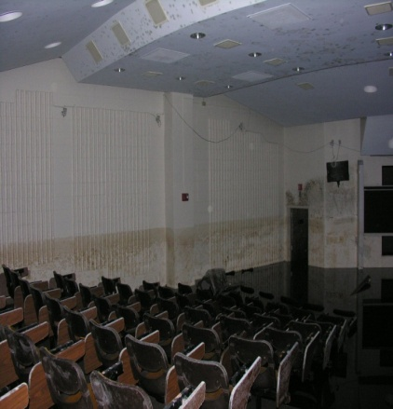

“Be Proactive”
Plan and Prepare
#1
Documentation will be the key to successfully addressing any disaster
Photographs of existing conditions (prior to storm) would speak volumes – A picture is worth a 1,000 words
Along with pictures of pre-disaster conditions, you should be prepared to present invoices, repair logs, warranties, work order history…
NCF 105
October 2005
TMA Systems

Slide 11
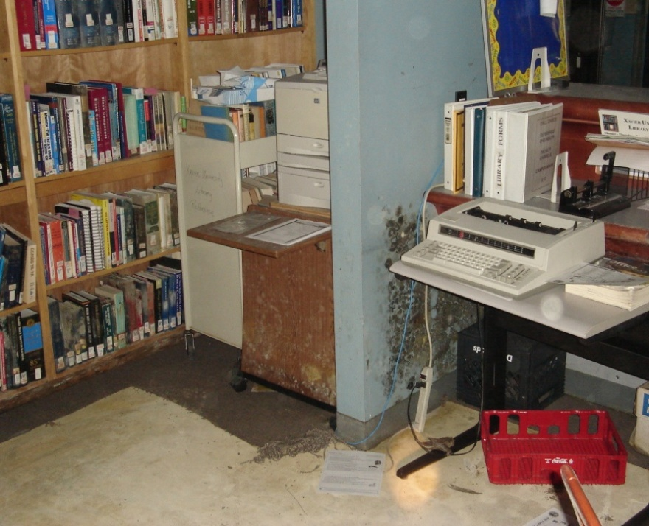
“Begin with the end in mind”
#2
On September 9, 2005, Xavier’s President, Dr. Norman C. Francis, met with key administrators in a remote location 3 hours from New Orleans
It was determined that we must repopulate the campus by January 2006
We had our marching orders – the end was in mind
As an organization, you must know who is in charge and the supporting roles
Prioritize work
Office Space

Slide 12
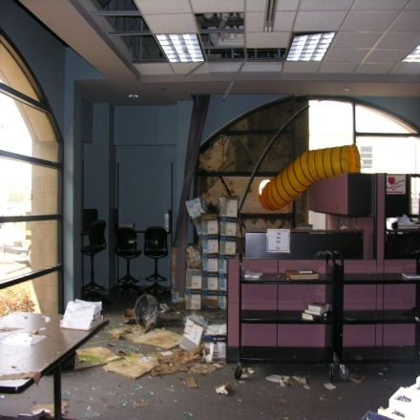
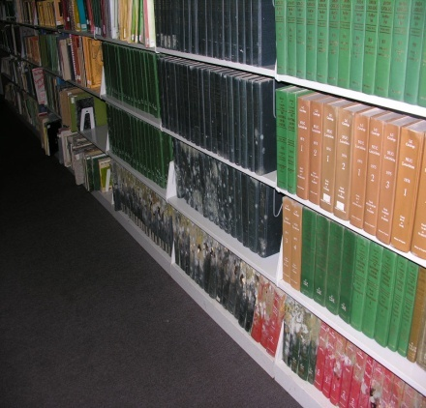
“Put First Things First”
Create a System that will allow Immediate Access to Damages
#3
Determine who should be allowed on campus – when, where, why, and in what areas
Resist the temptation – “Get-er-Done” – photograph/document before you start the clean-up or restoration process
Create a before-and-after disaster history – producing evidence of what was there and what is being replaced
Establish an alternate means of communications
Safety First (ALWAYS!)
Library
October 2005

Slide 13
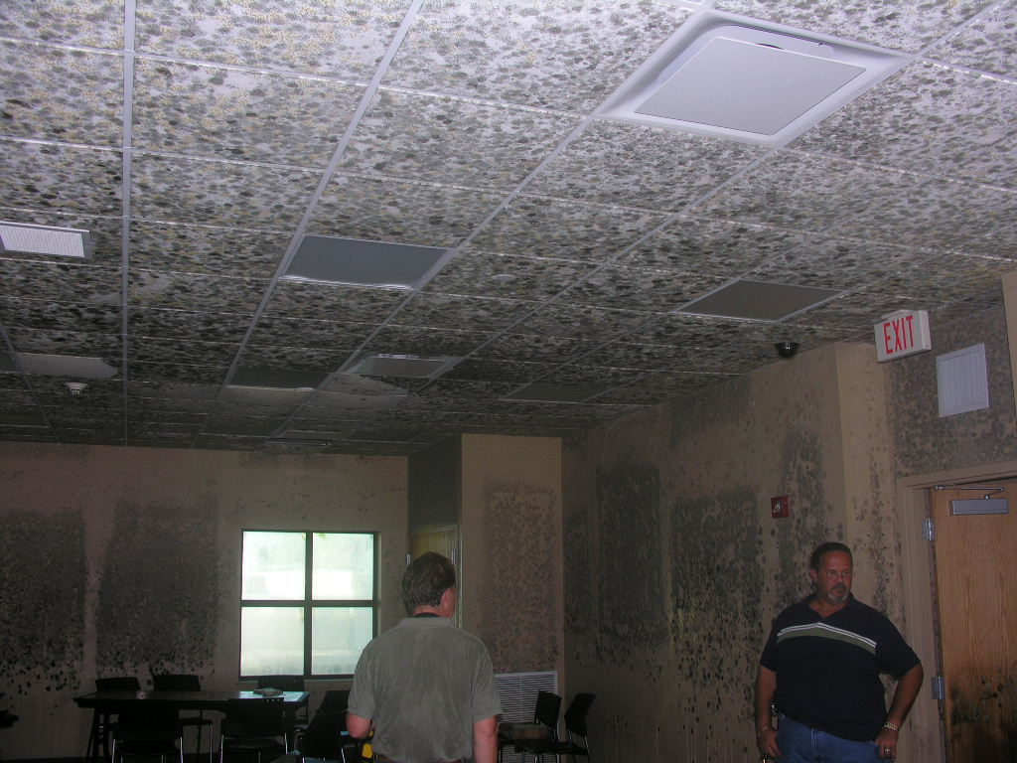
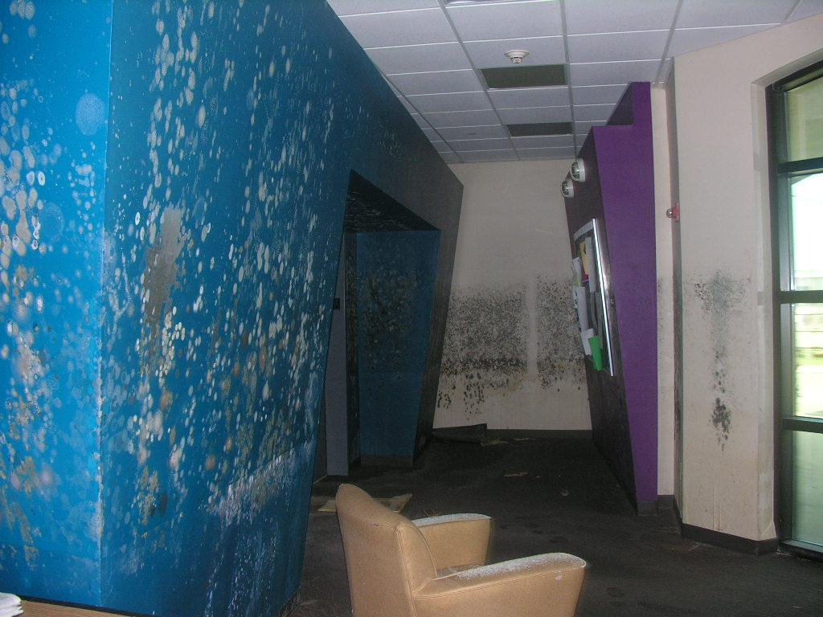
“Think Win – Win”
In order for you to achieve your goal, we must assist others (FEMA, Insurance Companies) to make the correct damage assessment
#4
Designate at least one knowledgeable team member to walk the campus with your guest
Provide needed information to start your claim or the Project Worksheets (PWs)
FEMA responds better to photographs than statements
Become familiar with the Stafford Act
Student Housing

Slide 14
“Seek First to Understand and then to be Understood”
What is the Funding Source(s) of this Recovery/Restoration?
#5
Understand – FEMA reimburses in most situations; the Institution must expend funds prior to receiving the funds from FEMA
Understand – The reimbursing process is NOT IMMEDIATE
Understand – What will your insurance cover
  This amount will be significant for the FEMA PWs
Understand – The method(s) of funding a disaster
  Insurance, Loans, Endowment, Gift, etc.

Slide 15
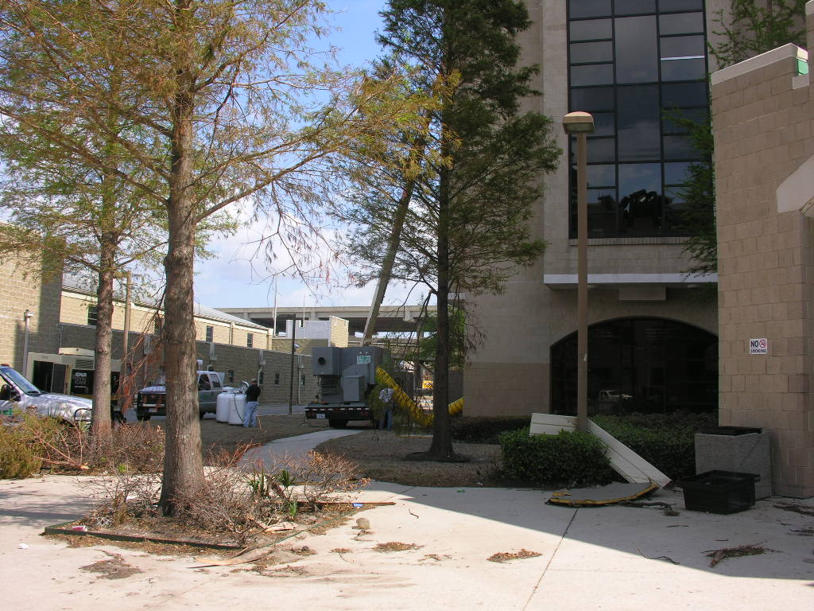
“Synergize”
After the Recovery or Restoration, There’s Mitigation
#6
Examine solution – preparing for the next big one
Seek funding that will assist in things such as raising equipment to a higher level – hurricane strength windows, flood-proofing the first floor of the Library, no first floor labs, etc…
Upgrade buildings to meet current codes/standards
Temporary Power

Slide 16
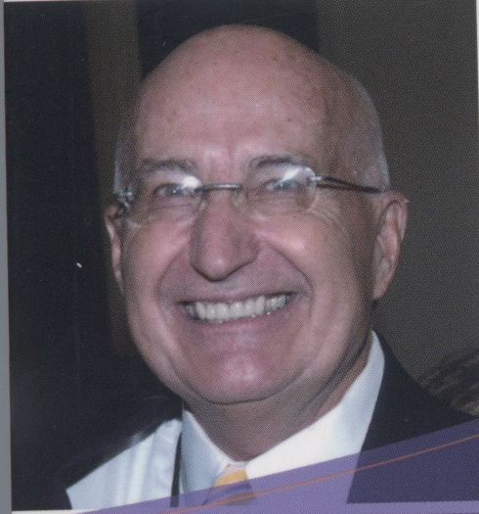

“Sharpen the Saw”
When it’s all said and done, Review
#7
Review your entire Emergency Plan
Determine when evaluation is necessary and how it will be impacted by others (city, state)
Determine who will remain behind, if anyone
Determine who are the first responders
Share your plan with the campus, municipalities and with peer institutions
KISS Theory (simplicity)
Watch out for the Human Factor/Reaction
John R. Johnson, former Senior Vice President, TMA Systems

Slide 17
Take-Aways & Victories

Slide 18





Establish Relationships
…with trade organizations
  Access to resources and support
…with vendors and companies
  Helps to have people to call on in an emergency or go-to contractors in expedited bid processes
…with each other
  Share cards and contacts; we can help others who are going through the same things
…with a Supreme Being

Slide 19
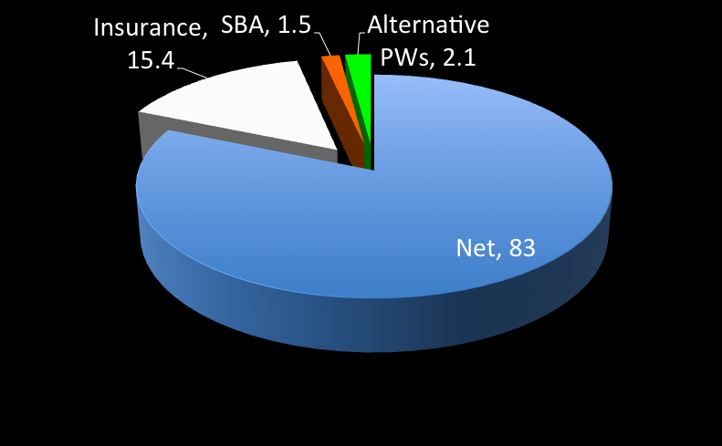
Xavier university gross recovery using Federal funds
Gross Recovery = $102 Million
Net Recovery = $83 Million
Expected Recovery = $5 Million
Although sometimes the relationship was strained, FEMA was very supportive
20 FEMA Teams
Different interpretation of the regulations

Slide 20
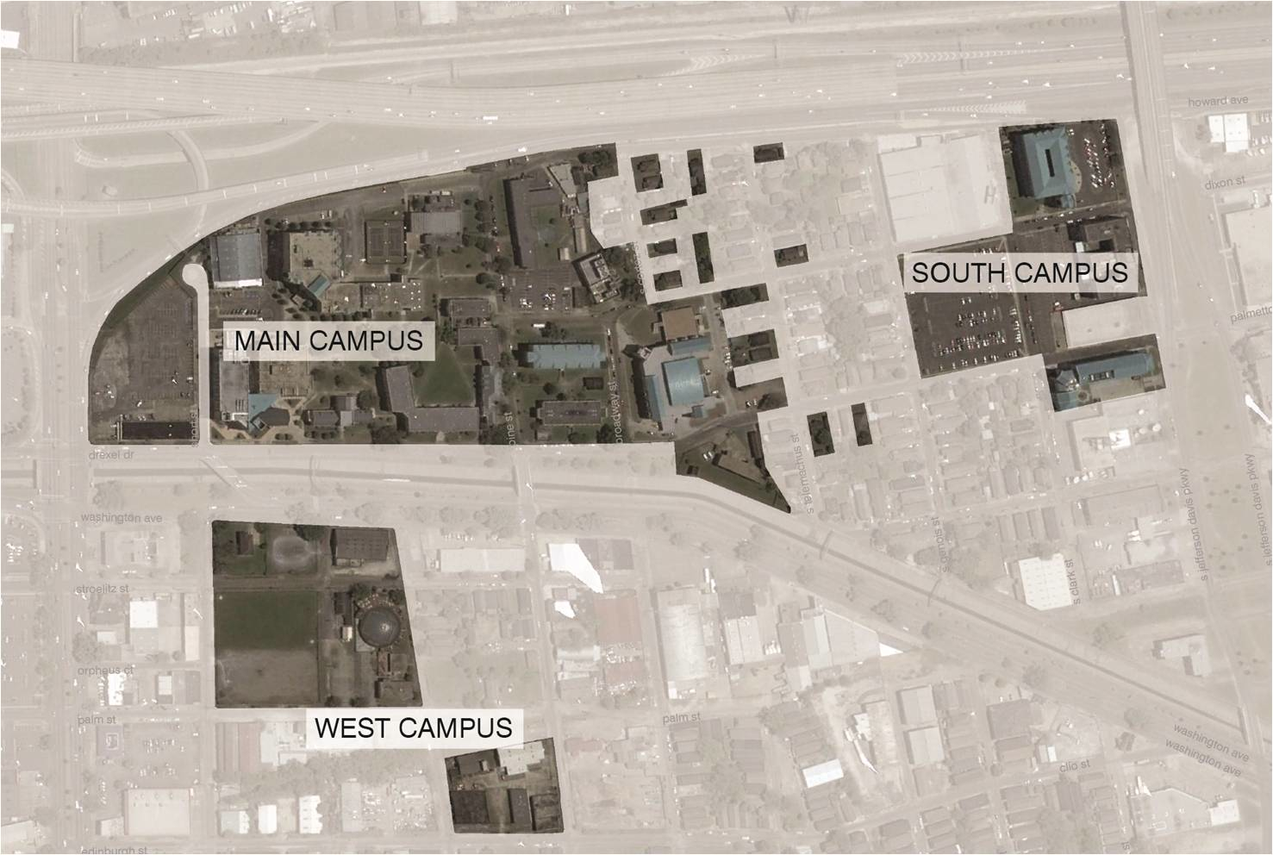
Xavier Campus 2005
Main Campus 24.5 acres
Xavier South 8.1 acres
West Campus 7.3 acres
Additional 1.2 acres
Total 41.3 acres

Slide 21
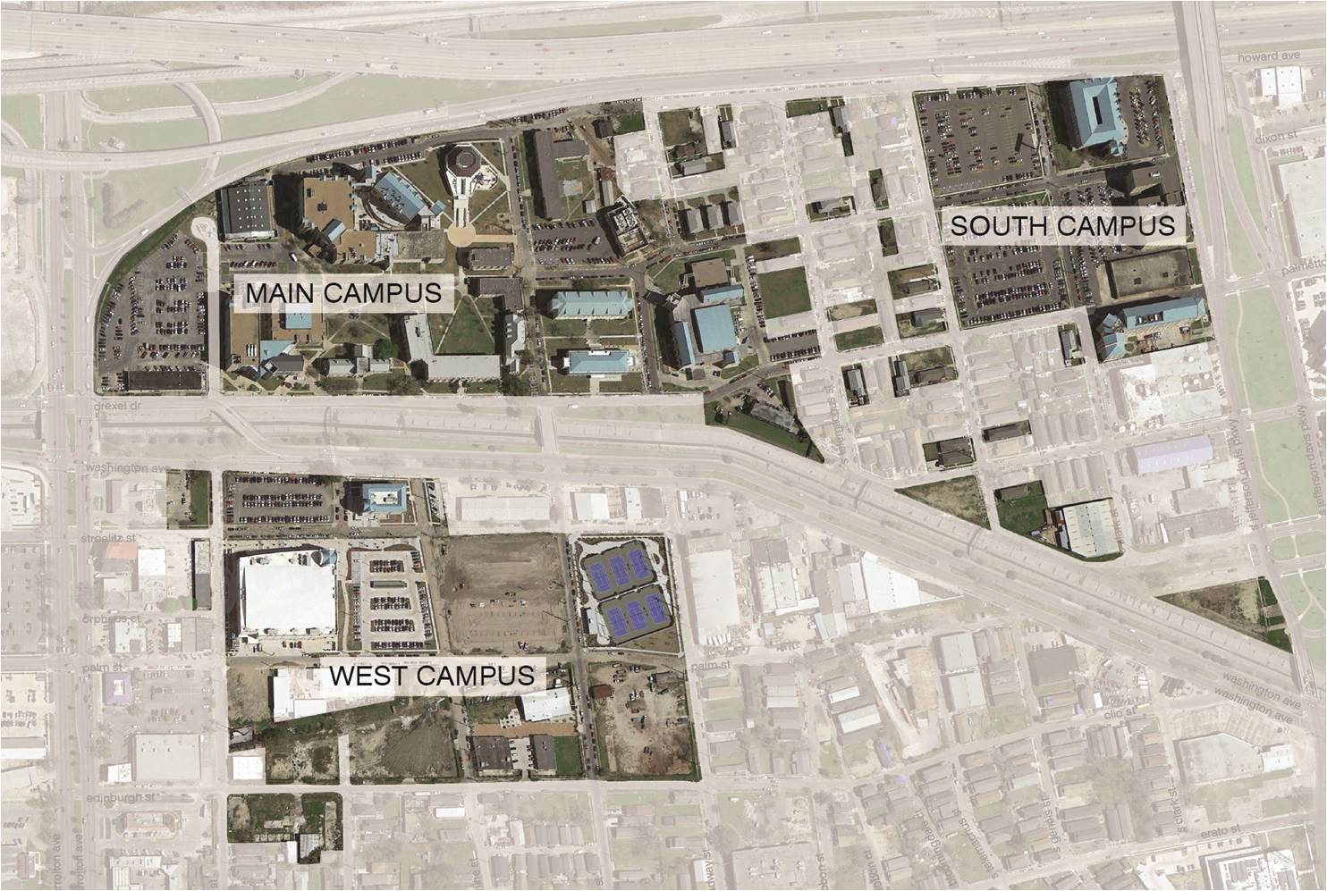
Xavier Campus 2015
Main Campus 25.0 acres
Xavier South 10.6 acres
West Campus 18.9 acres
Additional 8.0 acres
Total 63.4 acres

Slide 22
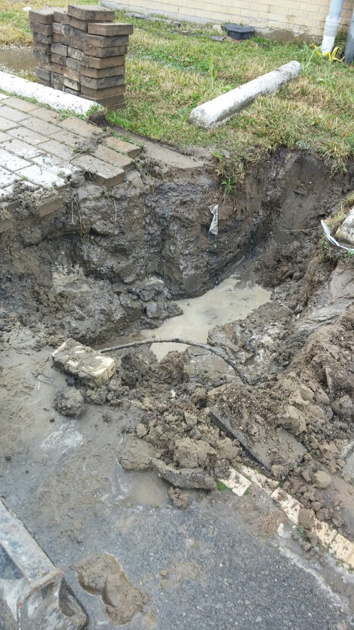
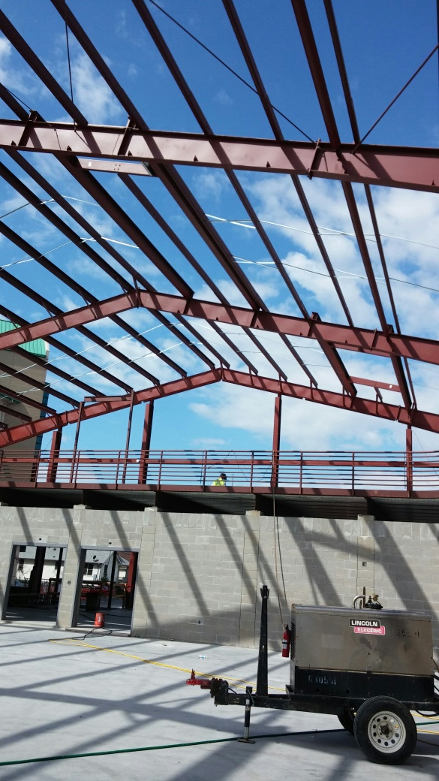
Active & Anticipated projects
Student Fitness Center
Replace Art Gallery
Replace physical plant
Electrical upgrade
Additional exterior renovations – campus wide
Latent damage (underground water leak)

Slide 23
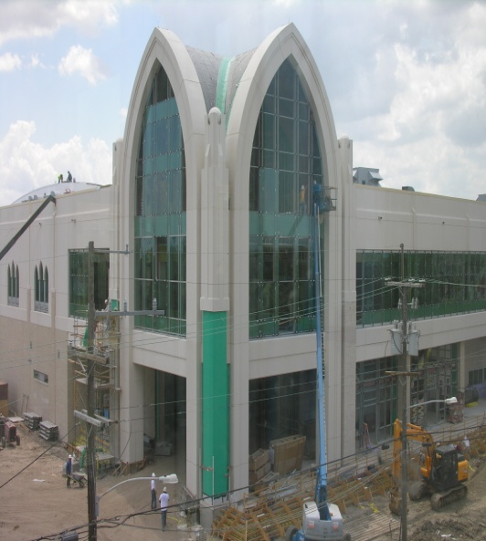
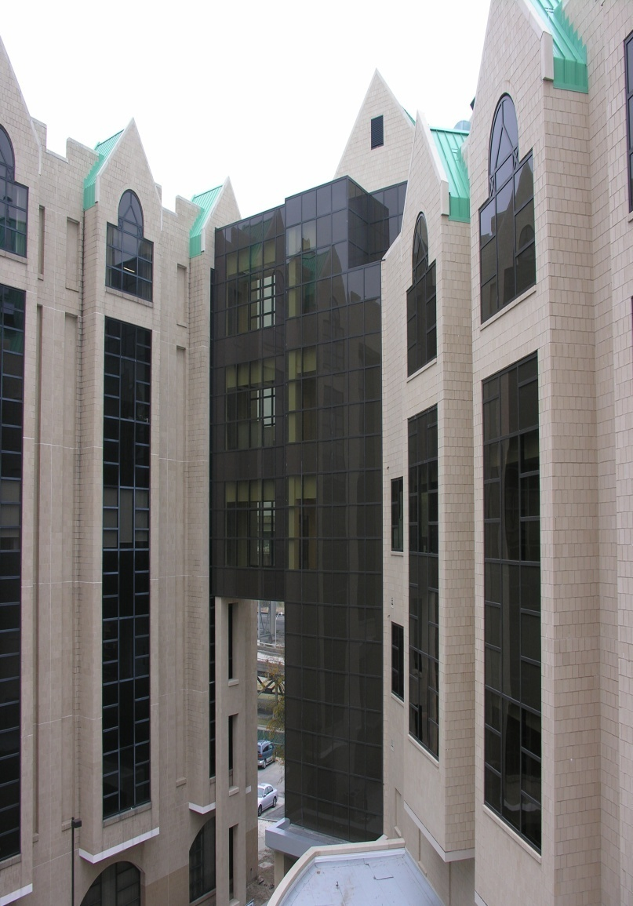
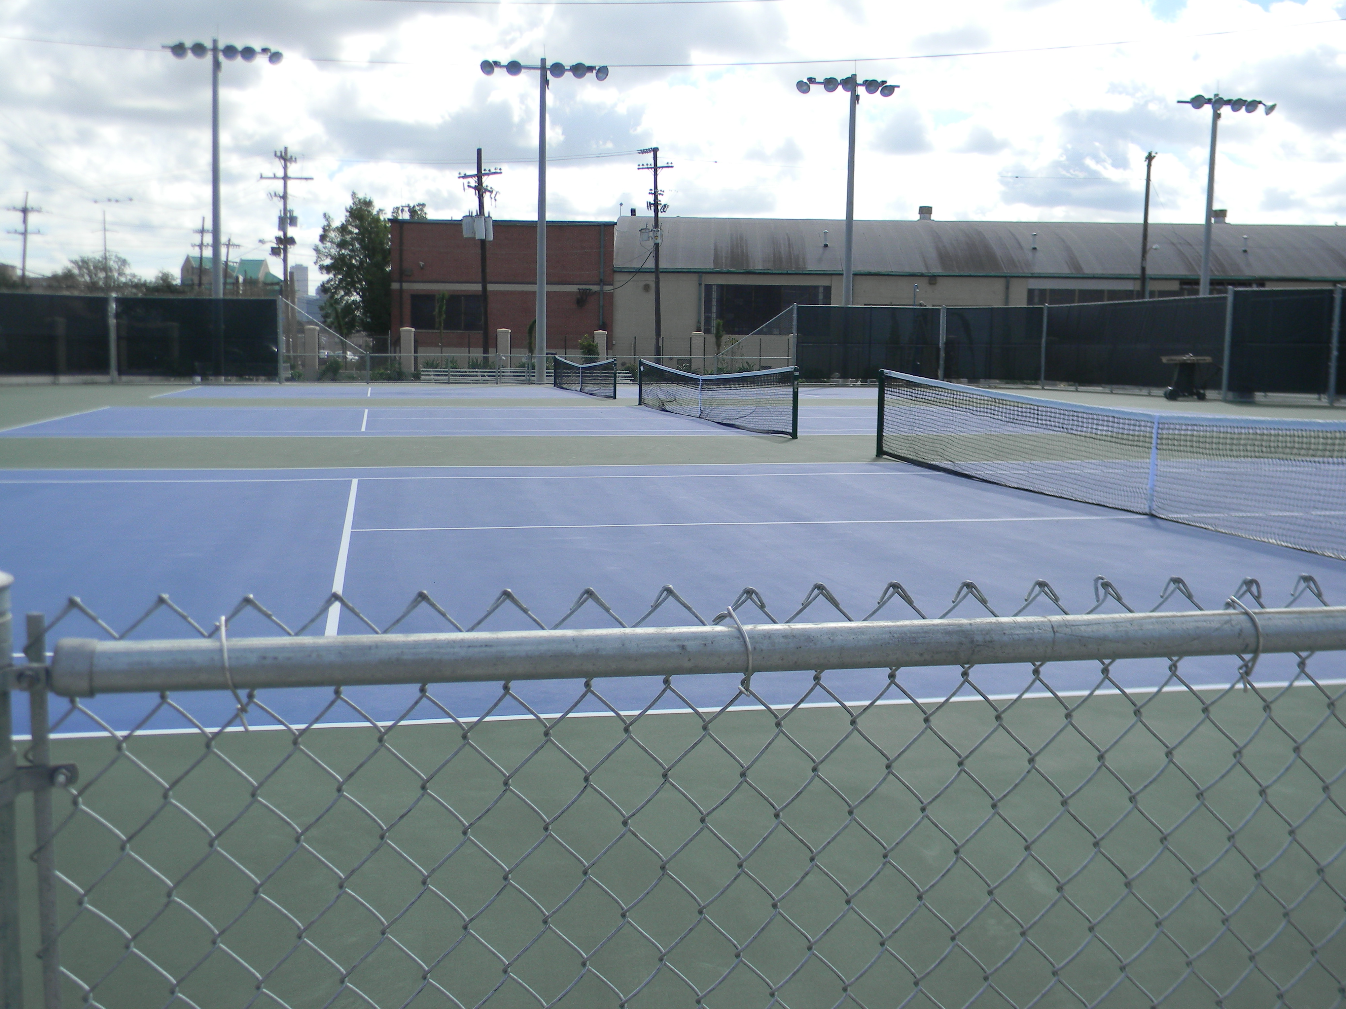
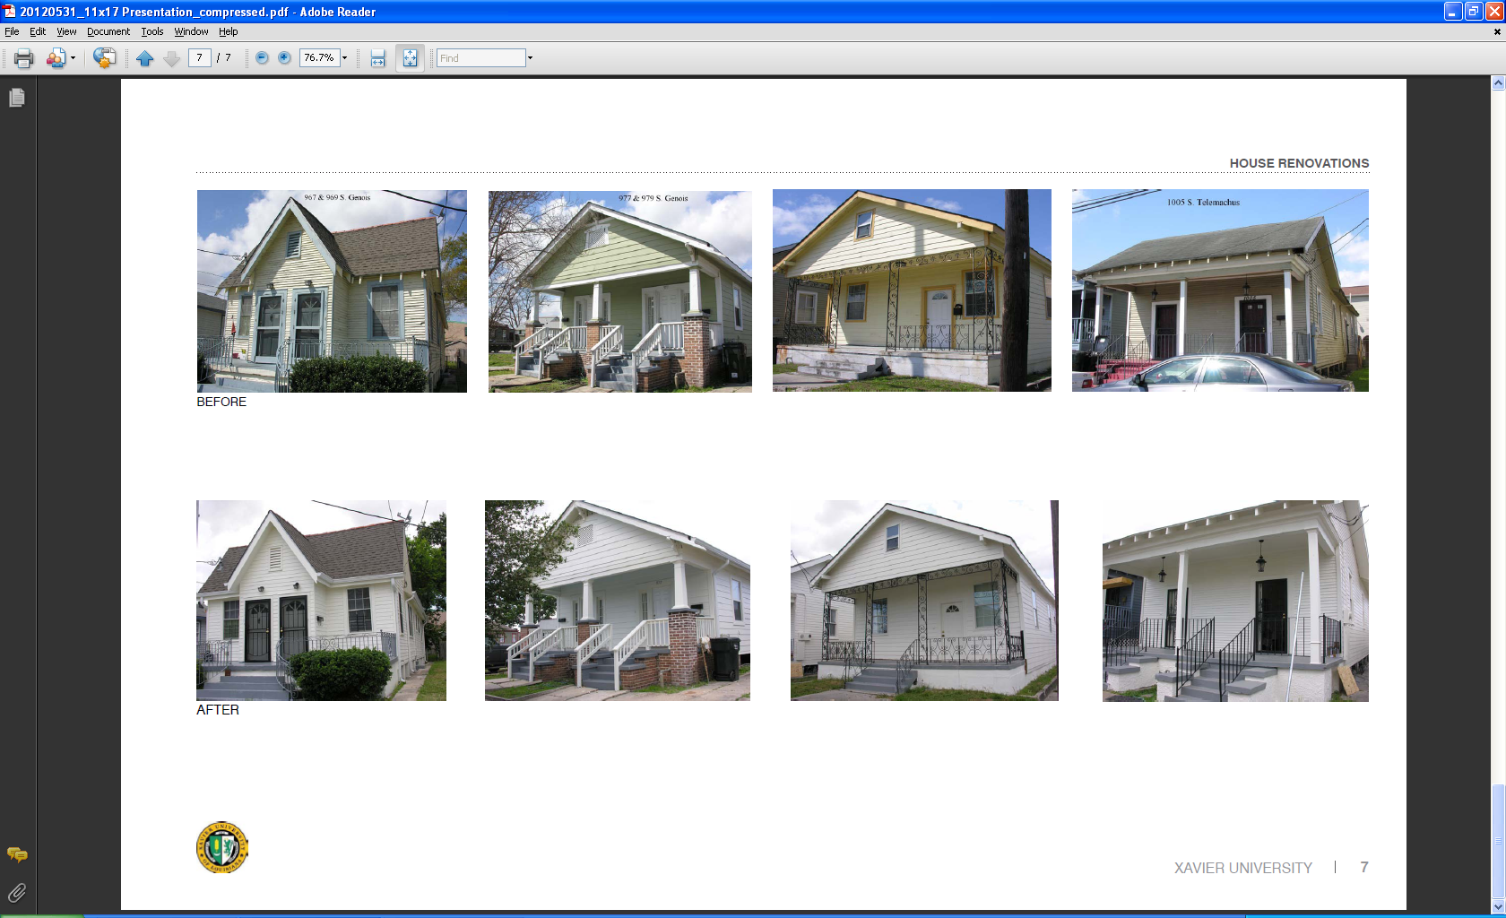
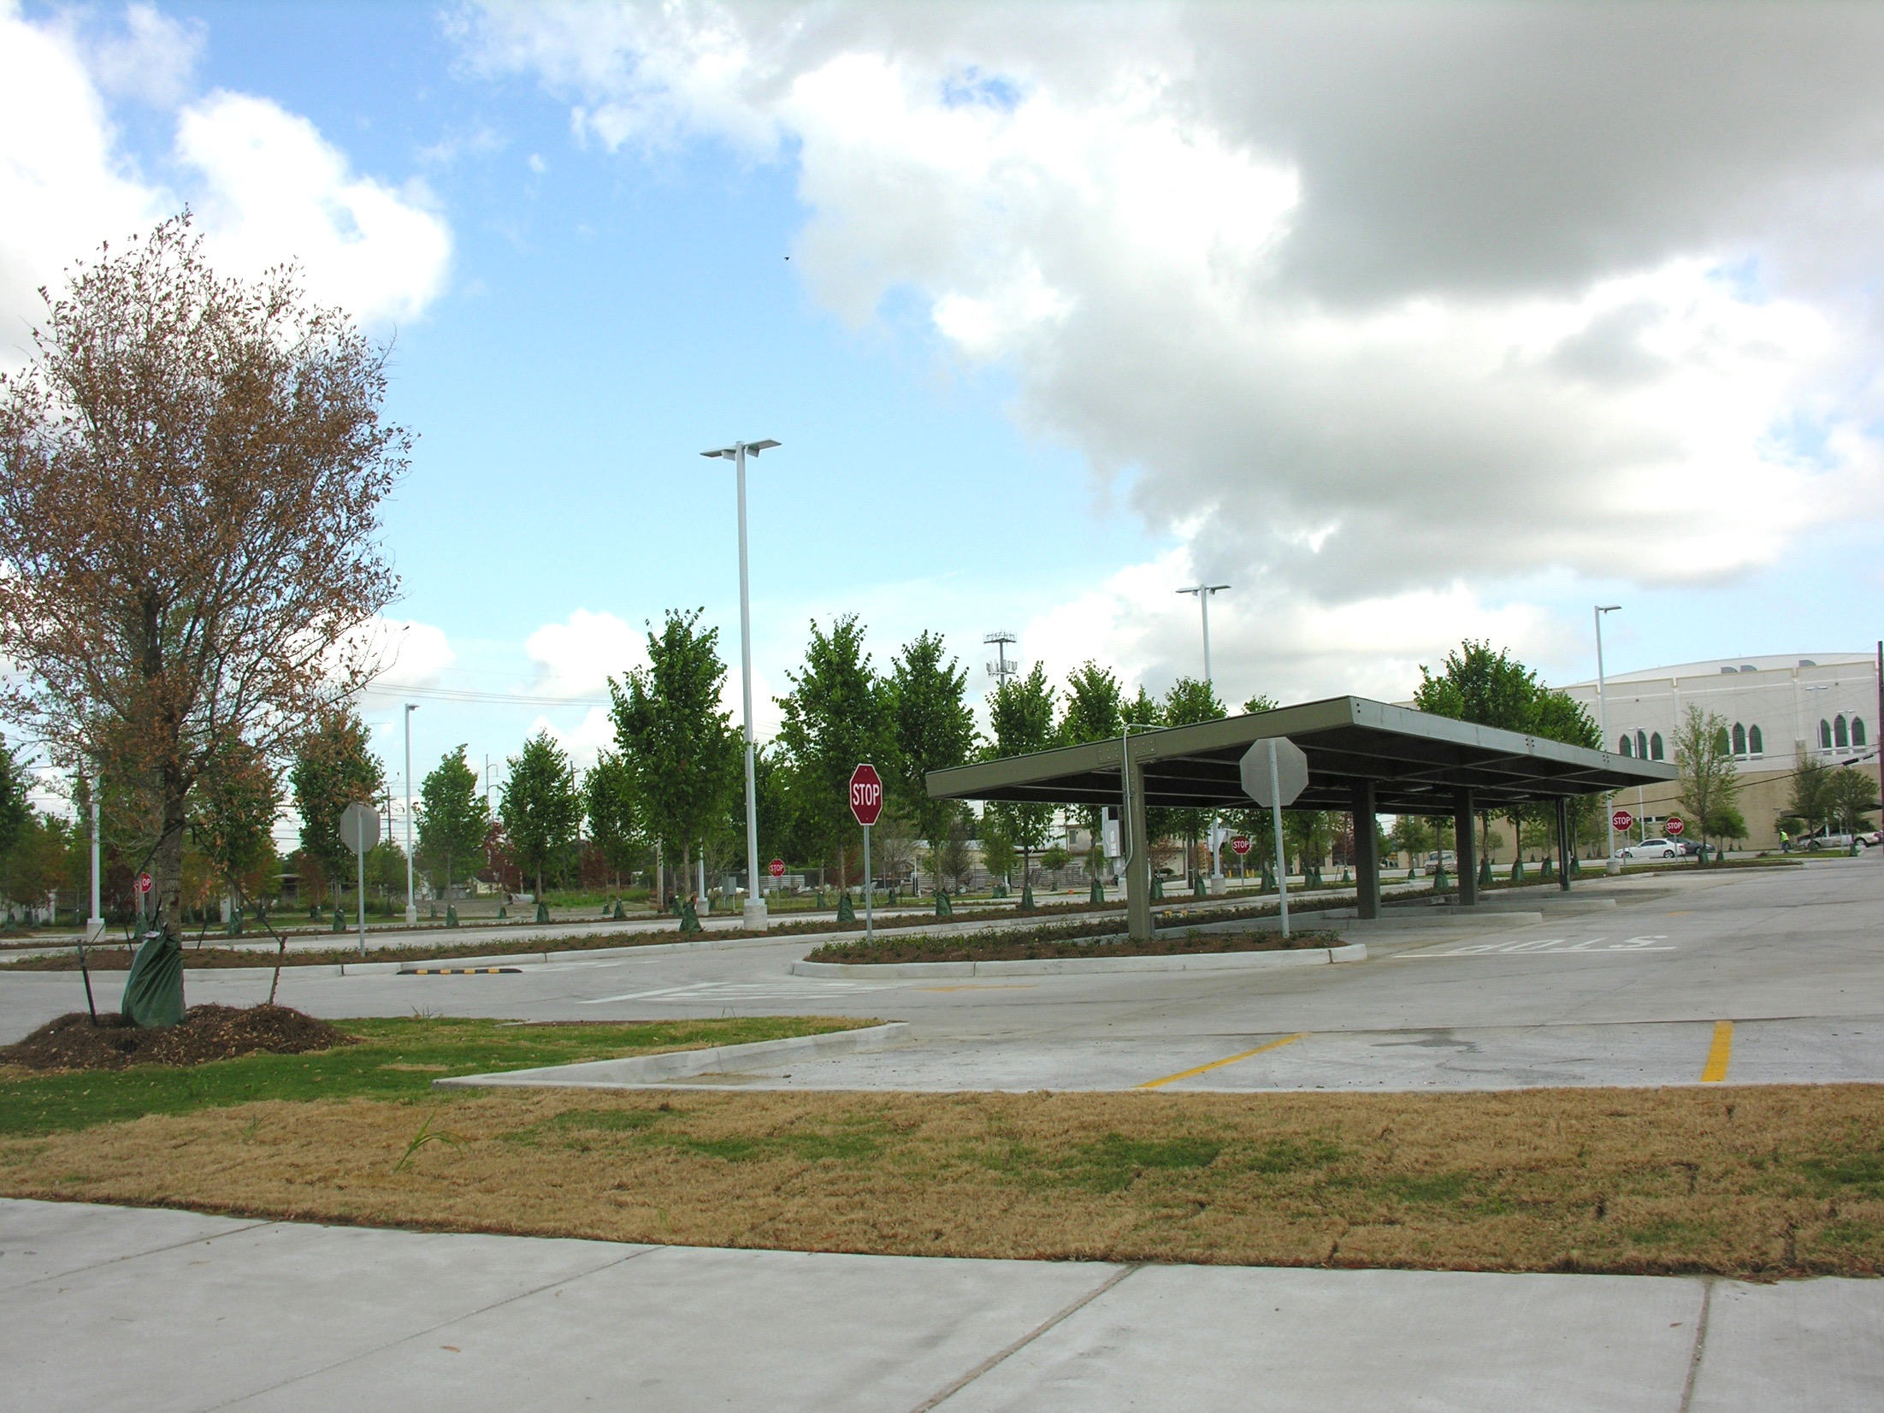
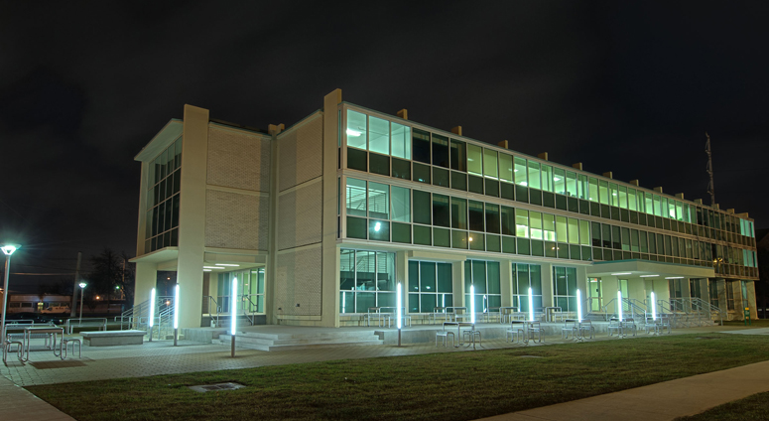
The long Road to recovery
9 Years 7 Months 14 Days
LEED Certified
Improved PW
Tennis Courts
Improved PW (over 50% damages)
Convocation Academic Center (CAC)
External Funding
Qatar Pavilion
Replacement PW
Housing Renovations
APPA Effective & Innovative Practice Award-Winning Pervious Concrete
Alternate PW
St. Joseph Academic and Health Resource Center

Slide 24
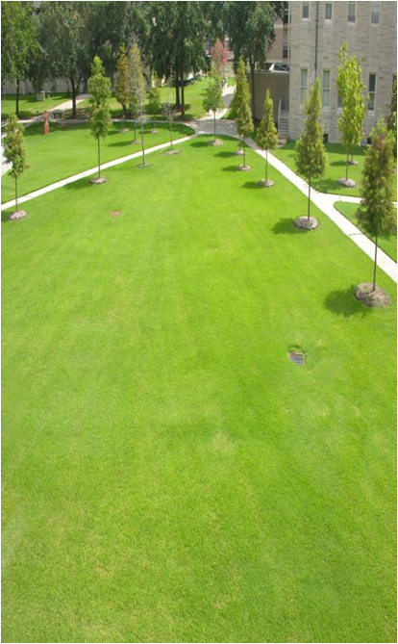
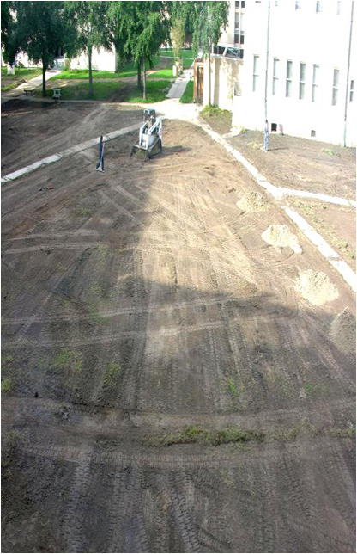
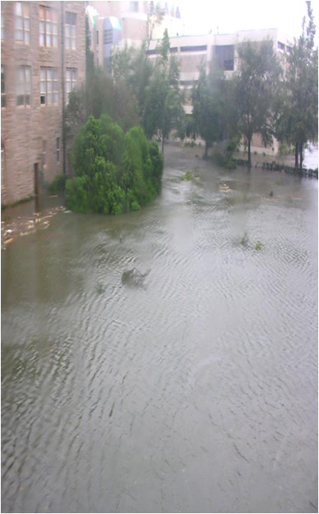
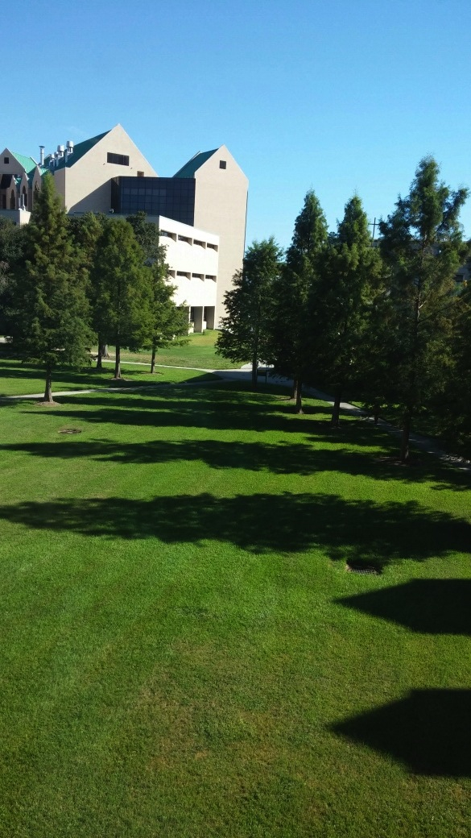
When failure is not an option….
…how do we maximize success?

