Slide 1
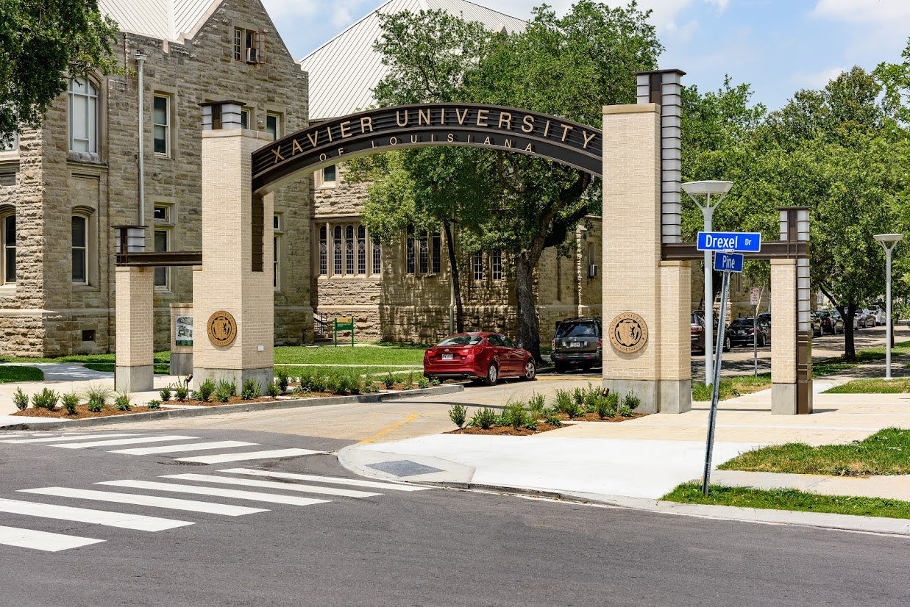
Financial Aid Townhall

Slide 2
Agenda
Welcome and Introduction of Panelists
Emergency Aid Program
Financial Aid Process and Deadlines
Merit Scholarships for Continuing Students
Financial Aid Appeals Process
Important Next Steps
Fiscal Clearance
Payment Plans
Q&A

Slide 3
Emergency Aid

Slide 4
Emergency Aid
For currently enrolled Xavier students
Complete COVID-19 survey (link provided via email)
Emergency Aid Application Process
Access “Cares Emergency Grant Application”
Application available on xula.edu
Complete application in its entirety
Email completed application AND supporting documents to emergencygrant@xula.edu

Slide 5
Financial Aid

Slide 6
Financial Aid Process & Deadline
Complete FAFSA
Fafsa.gov or studentaid.gov
Summer School – Requires 2019/2020 FAFSA
Fall Term – Requires 2020/2021 FAFSA
Financial Aid Offer Notification – sent to XULA email
To accept/adjust/decline – visit Banner Web
Parent Plus Loans cannot be accepted by student
For additional information visit xula.edu/financialaid

Slide 7
Financial Aid Process & Deadlines
Congratulations Graduating Seniors!
Exit Counseling Extended to May 1
Summer School
Deadline Extended to May 8
FAFSA & Verification Documents
June 1 – Financial Aid/Estimated Offer
Professional Judgment
June 1
Satisfactory Academic Performance (SAP) Appeal
July 10

Slide 8
Scholarships
Continuing Students - Merit Scholarship Update
TOPS (Louisiana Students)
Continuing
Incoming
Visit Scholarship Search Database for Outside Scholarship Opportunities

Slide 9
Financial Aid Appeals
Satisfactory Academic Progress
Not meeting – Email notification with details
File an appeal on or before July 10
Professional Judgement
For extenuating circumstances that caused a substantial change to income call financial aid office ASAP
June 1

Slide 10
Fiscal Clearance

Slide 11
Fiscal Clearance Process and Deadlines
If you have a zero or credit balance you will automatically be Fiscally Cleared.
If your financial aid (including scholarships) does not cover the entire cost of tuition, fees and housing (if applicable) you will have a “minimum payment required”.
Please submit your required minimum payment to be Fiscally Cleared. Payments can be made online by logging into your Banner Web account or by mail:
Xavier University of Louisiana
Office of Student Accounts
1 Drexel Drive, Box 121
New Orleans, LA 70125
Required payment (1/2 due to the Office of Student Accounts) by the following dates:
May 20, 2020 – Summer 1 & 3, 2020
June 22, 2020 – Summer 2, 2020
July 17, 2020 – Fall 2020

Slide 12
Payment Plan Process
Summer 2020 Payment Plan
Summer 1: May 25 is the final day for fiscal clearance. The final payment for Summer 1 is due on or before June 26, 2020.
Summer 3: June 5 is the final day for fiscal clearance. The final payment for Summer 3 is due on or before July 31, 2020.
Summer 2: June 26 is the final day for fiscal clearance. The final payment for Summer 2 is due on or before July 31, 2020.
Fall 2020 Payment Plan
By fiscal clearance deadline, July 17, ½ of the balance after financial aid is due.
½ of the remaining balance is due on or before Sept 30, 2020.
Final payment is due on or before October 31, 2020.

Slide 13
Important Contact Information
Emergency Funding – emergencygrant@xula.edu
Financial Aid – finaid@xula.edu
Student Accounts – stuaccts@xula.edu

Slide 14
Questions?

